Slide 1


Capital District Pop Warner Education PROGRAM
For Coaches, Commissioners, and Other volunteers

Slide 2
CDPW Volunteer Training
This Training is for all Presidents, Commissioners, Cheer/Football Coordinators, and Coaches.
  Coaches are responsible for managing the team/squad.
  Commissioners are responsible for administrating the game and rules.
  EVERYONE is responsible for following the rules!
As a volunteer, it is your responsibility to support the goals and philosophies of the Pop Warner program.

Slide 3
Other Clinics/trainings - Football
Coaches: USA Football/Heads Up Online Training (popwarner.com)
Tackle: Mandatory for ALL Head and Assistant Coaches
Flag: Mandatory for Head + all assts.
Certificates must be in Team Book behind coach ID Card
$10.00; must complete by August 1st; valid for year
DPW Flag Coach Clinics (TBD)

Slide 4
Other Clinics/trainings - Cheer
JAMZ – YCADA Coaches Course (popwarner.com)
  Mandatory for ALL on roster (Head/Asst./Jr. Coaches, Cheer Coordinator, Team Parents, etc.)
  Must complete by Aug. 1- Valid for 2 years.
  Certificates must be in Team Book.
  $25.00 if before July 31; $30.00 after July 31.
YCADA’s Competitive Edge (popwarner.com)
  Recommended for Coordinators/Coaches
  $30.00
Eastern Region Cheer Coaches’ Clinic
  TBD

Slide 5
AGENDA
Unit 1: Pop Warner Overview
Unit 2: Your Association
Unit 3: Risk Management
Unit 4: Game Day Procedures
Unit 5: Keeping Youth Sports Fun
Closing Remarks and Questions

Slide 6


UNIT 1: Pop Warner Overview
History, Philosophy, Structure

Slide 7
History of Pop WArner
1934: College coaches were invited to speak at a clinic for the Junior Football Conference (JFC). Bad weather kept away all but one - Glenn Scobie "Pop" Warner from Temple University. He spoke with the players for two hours -- by the end of the evening, the program was renamed the Pop Warner Conference.
1959: Pop Warner Little Scholars (PWLS) was incorporated as a national non-profit organization. The name was selected to emphasize that the classroom is as important as the playing field.
Today: PWLS is the largest youth football, cheer and dance program in the world with 325,000 participants in 42 states and several countries. It is the only national youth sports organization that requires its participants to maintain academic standards in order to participate.

Slide 8
Pop Warner MISSION
To enable young people to benefit from participation in team sports and activities in a safe and structured environment. Through this active participation, Pop Warner programs teach fundamental values, skills and knowledge that young people will use throughout their lives.
Pop Warner seeks to:
provide fun athletic learning opportunities, while emphasizing the importance of academic success.
Familiarize players and spirit participants with the fundamentals of football, cheerleading and dance.
inspire youth, regardless of race, creed or national origin, to practice the ideals of sportsmanship, scholarship and physical fitness as reflected in the life of the late Glenn Scobie “Pop” Warner.

Slide 9
Organizational STRUCTURE
National Pop Warner Little Scholars, Inc.
Executive Director: Jon Butler
REGION: Eastern
Region Director: Harry Harrington
LEAGUE: Capital District
President: Dan Martuscello
ASSOCIATION: ex: albany

Slide 10
CDPW Board of Directors
Dan Martuscello
President
Don Delong
1st Vice-President (Football)
Yvonne Cleveland
2nd Vice-President (Cheer)
Tom Hindes
Treasurer & Challenger Commissioner
Judi Byrnes
Secretary / Little Scholars
Sonia Rivera
Flag Commissioner
Shawn Hawkins
Webmaster / Jr Pee Wee Commissioner
Heather Mantica
Mitey Mite Commissioner
Don DeLong
Pee Wee & Jr. Varsity Commissioner

Slide 11
CDPW Associations
Albany
Ballston Spa
Bethlehem
Clifton Park
Cohoes
Colonie
East Greenbush
Greene County
Guilderland
No. Columbia County
Ravena
Rensselaer
Rotterdam
Saratoga
Schenenectady-Belmont
So. Glens Falls
South Troy
Troy

Slide 12
Unit 2: Your Association
Your BOARD, Coaches, and Teams

Slide 13
Association Board of Directors
Should Include…
May Include…
  President
  Vice President
  Secretary
  Treasurer
  Football Coordinator
  Cheerleading Coordinator
  Scholastic Coordinator
  Player Safety Coach
  Registrar
  Fundraising Chair
  Concession Stand Manager
  Equipment Manager
  Any other positions that will help your Association to run efficiently
All Board Members should attend monthly meetings to receive information so that your association members stay well-informed.

Slide 14
Background Checks
Annual Background Checks must be conducted on any persons who provide regular service to your Association and/or have repetitive access to, or contact with participants (e.g. Board of Directors, Coaches, Medics, Commissioners, and any other adults that appear on a team roster).
Each Individual completes the PWLS Volunteer Application and submits to your Association.
Association submits the PWLS Association Affidavit, along with a list of those checked, to CDPW before August 1st. CDPW forwards to National.
PWLS Volunteer Application and Affidavit Form can be found on our website www.cdpopwarner.com under Forms

Slide 15
Football Formation of Teams:
Alpha Splitting
If there are multiple teams in same Division, participants must be divided equally and alphabetically by last name:
  “A” team (1st half of alphabet)- American Conference
  “B” team (2nd half of alphabet) - National Conference
  If needed, “C” team - players divided equally in thirds
Team splitting must occur after first 10 hrs of team practice.
Exceptions:
  Flag Football - equal distribution of 5, 6, & 7 year olds
  Coach & child/family members may remain together
Notes:
Neville’s Slide

Slide 16
Football Coaching Staff
A maximum of ten (10) staff positions:
  1 Head Coach (age 21 +)
  5 Assistant Coaches (age 18+)
  1 Coach Trainee (age 16-17)
  1 Equipment Manager
  1 Trainer
  1 Commissioner
Only these rostered staff and others with CDPW Field ID Tag are allowed on the field.
Ratio of children to coaches (age 21+) must be 12:1 at all events (practices, games, etc.).
Notes:
Neville’s Slide

Slide 17
Football Eligibility
A football player will be considered ineligible due to:
Participation in school tackle football program or any other non-affiliated football program and Pop Warner Football at the same time.
Players who have left their School program may be added to a Pop Warner team prior to the last Monday in October. However, they MUST already be on the roster and placed in “Inactive” status.

Slide 18
Cheer - Formation of Squads
Sizes: Small (6-12), Medium (13-24), Large (25-35)
When there are multiple teams/squads for the same division, they are split alphabetically, unless squads are different levels (i.e. PW2, PW3, etc.).
Squads must be attached to a football team, unless Association doesn’t have football program.
Mascots are only allowed if there is no Cub Squad.
  Must be 5+ years of age; maximum of 2 per squad
  May not perform stunts; can not perform at competition
Notes:
Neville’s Slide

Slide 19
Cheer Eligibility
Participants may individually enroll in non-Pop Warner affiliated instructional classes. However, Pop Warner cheer participants may not be officially enrolled in cheer or dance team that is not a School affiliated program. All-Star and other Recreational cheer and dance team participation is not permitted during the Pop Warner Season.

Slide 20
Cheer Coaching Staff
A maximum of nine (9) staff positions:
  1 Head Coach (age 21 +)
  4 Assistant Coaches (age 18+)
  Max of 4 Student Demonstrators/Coach Trainees Combined
    Maximum of 3 Coach Trainees (ages 16-17)
    Maximum of 4 Student Demonstrators (ages 15-17)
      Student Demos may be 14 ONLY IF rostered on H.S. team
Only these rostered staff and others with CDPW Field ID Tag are allowed on the field.
Ratio of children to coaches (age 21+) must be 12:1 at all events (practices, games, competitions).
Notes:
Neville’s Slide

Slide 21
Cheer Coach Trainees &
Student Demonstrators
Certified on roster like a spirit participant
  Must submit Birth Certificate, Physical Form, Report Card, etc.
Must be at least 2 years older than oldest child on the squad.
Must have at least 2 years Cheer/Dance experience.
May only teach cheers and demonstrate moves: no hands-on coaching
Notes:
Neville’s Slide

Slide 22
Practice Guidelines
Football & Cheer
BEFORE LABOR DAY
Up to 10 hours of practice per week
Not more than 2-1/2 hours on any one day
These limits apply to Year-Round Cheer, 1/1-7/31
AFTER LABOR DAY
Up to 6 hours of practice per week
Not more than 2 hours on any one day
Note:
A week is defined as 7 consecutive days.
Break time is not counted against allowed practice time.

Slide 23
Practice Guidelines - Football
Contact Limits:
  Prior to Labor Day: contact is limited to a max of 30 min/day and 120 min/week;
  After Labor Day: contact is limited to a max of 22 min/day and 65 min/ week
  “Contact” = drill or scrimmage in which players go full-speed with contact, (e.g. one-on-one blocking and/or tackling drills; down line vs down line full-speed drills; and/ or scrimmages)

Slide 24
Practice Guidelines - Cheer
After the first week of practice (10 hours) for conditioning, and after the second week of practice (10 hours) for conditioning, performer readiness evaluation, and/or camp/clinic, the squad may engage in regular practice sessions and/or pre-season games.

Slide 25
TEAM BOOK: Contents
National Pop Warner Rule Book
CDPW Commissioner’s Game Guide
Sportsmanship Statement Card
Team Documentation
  Team Roster
  Cheer Only: Skill Progressions and Declaration Checklist
  Head Coach ID card and Online Training Certificate
  Assistant Coach(es) ID Card(s) and Online Training Certificate(s)
  Participant Documentation
Notes:
25

Slide 26
Team BOOK: Participant Documentation
The following documentation is required for every Participant and Coach Trainee/Student Demonstrator (exact order provided on website):
  ID Card with picture attached
  Cheer only: Coach Trainees’/Student Demonstrators’ YCADA Online Certificates
  Copy of Birth certificate
  Physical Fitness/Medical History Form
  Participant Contract/Parental Consent Form
  June Report Card

Slide 27
Team BOOK: Order of Participants
Team Books should be completely assembled for CDPW Book Certification and Weigh-ins in August. Once the season starts, the football participant order CHANGES.
Football
  Book Certification/Weigh-Ins – Alphabetically
  Older/Lighter players first, then all other participants
  In-season – By Jersey #
  Older/Lighter players first (with CDPW red O/L stamp), then all other participants
Cheer
  Book Certification & In-Season - Alphabetically
  Coach Trainees/Student Demonstrators with Online Training Certificate(s) first, then all other participants

Slide 28
UNIT 3: Risk Management
Know the Rules to Minimize Risk

Slide 29
Risk ManagemEnt
Pop Warner Coaches Risk Management Handbook:
  Provides valuable information on how to manage your team to minimize risk of injury to athletes and risk of liability to yourself
  Distribute to all your Coaches; have them sign and return the last page to you

Slide 30
PWLS COACHES Risk Management Handbook
Properly plan activities
Provide appropriate supervision
Provide proper instruction
Provide adequate and proper equipment
Evaluate for injury or incapacity
Provide safe physical environment
Match athletes accordingly
Warn of inherent dangers
Initiate medical response

Slide 31
Risk Management Handbook:
A. Properly Plan Activities
Plan practice activities in advance. Document the time spent and the techniques taught.
  Documentation ensures proper procedures are followed and aids in your defense in the case of alleged negligence.
  Advance planning results in more organized and effective practices with fewer accidents.

Slide 32
A. Properly Plan Activities (Cont’d)
Incorporate the following elements into practices and games/competitions to ensure that athletes avoid injury:
Warm-up (10 minutes) and cool-down (10 minutes)
  No more than 30 minutes of warm-up before games and competitions
Training
  Training methods and frequency, duration, and intensity of practices should vary among athletes based on age, experience, physical conditioning, mental state, and training goals.
  The purpose of training is to prepare for competition – it is NOT to be used as a disciplinary activity, unsupervised play, or competition itself.

Slide 33
A. Properly Plan the Activities (Cont’d)
An effective practice includes:
  Practicing previously taught skills
  Teaching and practicing new skills
  Practicing under competitive conditions
  Discussing things that need improvement, were successful, or need to be eliminated

Slide 34
Risk management Handbook
B. Provide Appropriate Supervision
Coaches are responsible for providing appropriate supervision to prevent unnecessary risk of injury.
There are two types of supervision:
  General: oversight of all areas and events taking place during the session, whether training or competition.
  Specific: oversight of specific elements or skills being performed.

Slide 35
B. Provide appropriate supervision (Cont’d)
A coach’s supervisory responsibilities start when the first athlete arrives and do not end until the last athlete leaves.
Coaches should avoid any situation where a single coach is alone with one or more minors.
  Coaches are responsible for setting the standard of behavior for the team/squad. Additionally, it is the Head Coach’s responsibility to control the actions and attitudes of the athletes, coaching staff and parents.
  Appropriate behavior according to the Coaches Code of Conduct.

Slide 36
Risk management Handbook
C. Provide Proper Instruction
Coaches are responsible for instructing athletes on sport-specific techniques and skills, game rules, safety rules, and sportsmanship.
  Introduce the Skill
  Demonstrate the Skill
  Explain the Skill
  Pay specific attention to athletes Practicing the Skill
It is your responsibility to improve your coaching skills by taking classes, reading books, going to clinics, etc. that will allow you to give proper instructions on technique.
Do NOT attempt to teach skills that YOU DO NOT
know or understand.

Slide 37
Risk management Handbook
D. Provide Adequate & proper Equipment
Equipment must be:
Inspected prior to each practice and game
High quality and in good condition
Sized properly and fitted correctly
Maintained and repaired/replaced when damaged
Coaches should never modify equipment without consulting with and obtaining written consent from the manufacturer. Any modifications to equipment may void equipment warranties and create liability.

Slide 38
Risk management Handbook
E. Evaluate for Injury and Incapacity
Sports injury care consists of two basic elements:
Prevention: Coaches should incorporate methods for preventing injuries and illnesses in their coaching programs including pre participation screening, strength training, conditioning, and awareness of the nature, cause, and mechanisms of sport specific injuries.
Recognition and Treatment: Once the coach realizes that an injury or illness has occurred, the magnitude must be assessed and appropriate care initiated.
Forcing ill or injured athletes to participate
is not acceptable!

Slide 39
E. Evaluate for injury and incapacity (Cont’d)
Follow Return-to-Play Guidelines
If removed from game due to injury, participant must sit out at least one down, and may not re-enter game without approval of attending medical personnel.
When in doubt, play it safe!

Slide 40
Risk management Handbook
F. Provide Safe Physical Environment
Coaches are responsible for inspecting all areas to be utilized in practice and competition to identify hazards.
Coaches should document their facility inspections – this can be beneficial in defending against certain lawsuits.
It is not sufficient simply to identify a hazard. You should take action by having the item corrected, posting warning signs, and/or keeping athletes/spectators away from the hazard.

Slide 41
F. PROVIDE SAFE PHYSICAL ENVIRONMENT (Cont’d)
INCLEMENT WEATHER
Monitoring weather conditions is the responsibility of the Game Officials, Coaches, Association and League Commissioners.
Prior to a game, Coaches and Officials should discuss the procedures they will follow in case of inclement weather.
If lightning is within 5 miles, (i.e. 30 seconds or less between lightning and thunder), the game should be suspended and shelter sought. Games should not be restarted for at least 30 min. after last roll of thunder is heard.

Slide 42
Risk management Handbook
G. Match Athletes Accordingly
Coaches have a duty to match athletes at a similar competitive level to reduce the risk of injury and avoid unfair competitive advantage.
Skill, experience, height, weight, age, injuries, maturity, mental state and gender ALL must be considered when matching participants.
Numerous court cases have arisen out of the failure of a sports organization to appropriately match the size, age and skill of athletes.

Slide 43
Risk management Handbook
H. Warn of Inherent dangers
Failure to advise and inform athletes and parents of the risks of participation is a prevalent allegation in sports injury litigation.
Consider an Orientation Meeting to discuss:
  Risks involved with the sport and what injuries may occur
  Injury prevention measures that are used at games/practices.
  Importance of using, inspecting and maintaining proper equipment
  Emergency procedures that will be used

Slide 44
Risk management Handbook
I. INITIATE MEDICAL RESPONSE
At ALL practices & games/competitions there MUST be:
  At least one coach or medic, certified in basic first aid/CPR
  First Aid Kit (see Risk Management Handbook for content suggestions)
  Team Book so medical and contact information is readily available
Purpose of First Aid it to stabilize the situation to prevent it from worsening until a doctor can provide further treatment – do not exceed the scope of your training!

Slide 45
I. INITIATE MEDICAL RESPONSE (Cont’d)
Basic Duties of First Aid
Check the scene for safety
Check the injured athlete and protect from further harm, following universal precautions when appropriate (e.g. latex gloves; all bleeding must be stopped before returning to practice/game; properly dispose of all materials.)
DO NOT MOVE THE ATHLETE
Activate your “Emergency Medical Plan”
Care for the injured athlete until EMS arrives

Slide 46
I. INITIATE MEDICAL RESPONSE (Cont’d)
Emergency Medical Plan
All Head coaches must create an Emergency Medical Plan
  Plan should be in writing and readily available
  Plan should be reviewed with staff, participants, and parents
Plan should include who will:
  Attend to the injured athlete
  Supervise other participants
  Call 9-1-1
  Retrieve Medical/Contact Information from the Team Book
  Notify the parents if they are not present
  Document the incident
  Etc. (see Risk Management Handbook)

Slide 47
I. Initiate Medical Response (Cont’d)
Heat-Related Emergencies
Can be avoided by canceling practice in extreme weather (high temperature and/or high humidity) and taking frequent water breaks!!
Three categories of increasing severity:
Heat cramps – profuse sweating, fatigue, thirst, muscle cramps
Heat exhaustion – headache, dizziness, weakness/light-headedness, cool/moist skin, nausea/vomiting; dark urine
Heatstroke – fever; irrational behavior; extreme confusion; dry, hot, red skin; rapid, weak pulse, seizures; unconsciousness
Treatment:
Move athlete to a cool place.
Loosen tight clothing and remove perspiration-soaked clothing.
Fan athlete and give cool water to drink.
If the athlete refuses water, vomits, or starts to lose consciousness:
Follow emergency plan
Place athlete on his or her side
Hose with cold water
Continue to cool with ice packs on wrists, ankles, groin, neck and armpits

Slide 48
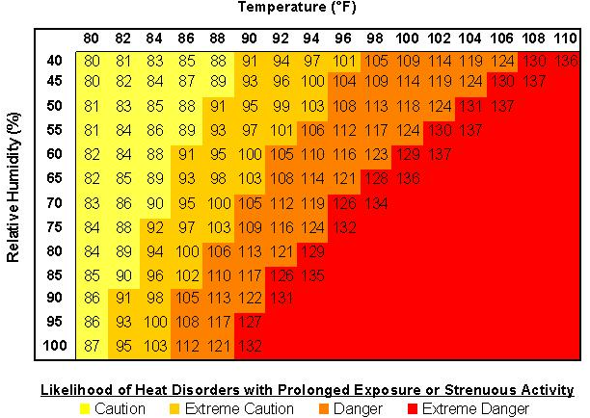
NOAA's National Weather Service Heat Index
48
http://www.nws.noaa.gov/om/heat/heat_index.shtml

Slide 49

I. Initiate Medical Response (cont’d)
Concussions - http://www.cdc.gov/headsup/

Slide 50
I. Initiate Medical Response (cont’d)
Concussions
How you can help decrease an athlete’s chance of getting a concussion:
Talk with athletes about the importance of reporting a concussion
  Emphasize that safety comes first and you expect them to tell you and their parent(s) if they think they have a concussion.
Create a culture of safety at games and practices:
Teach athletes ways to lower their chances of getting a concussion.
Enforce the rules for fair play, safety, and sportsmanship.
Ensure athletes avoid unsafe actions (e.g. striking another athlete in the head, using head/helmet to contact another athlete; making illegal contacts, etc.)
Tell athletes that you expect good sportsmanship at all times,
both on and off the playing field.

Slide 51
Risk Management: Insurance
Mandated insurance: Required for all Pop Warner Associations. Provides protection for practice fields, game fields, fundraisers, volunteers and drivers.
  CDPW provides accident insurance to all Associations
      It is a secondary policy with a $100 deductible.
      An Injury Report MUST be submitted to the appropriate League Commissioner within 5 days of injury.
  CDPW also maintains $2 million liability coverage.
  CDPW DOES NOT provide liability coverage for Association Officers or Directors. This coverage is highly recommended and may be obtained through PWLS.

Slide 52
Risk Management: Injury Report
Must be filled out any time a participant is withdrawn from game or practice due to injury.
Practice Injury reports must be filed immediately with CDPW.
Parent or guardian should acknowledge receipt of the insurance form by signing the Injury Report.
Game injury reports MUST be sent with game reports
Must be filled out any time a participant is withdrawn from game or practice due to injury.
Practice Injury reports must be filed immediately with CDPW.
Parent or guardian should acknowledge receipt of the insurance form by signing the Injury Report.
Game injury reports MUST be sent with game reports

Slide 53
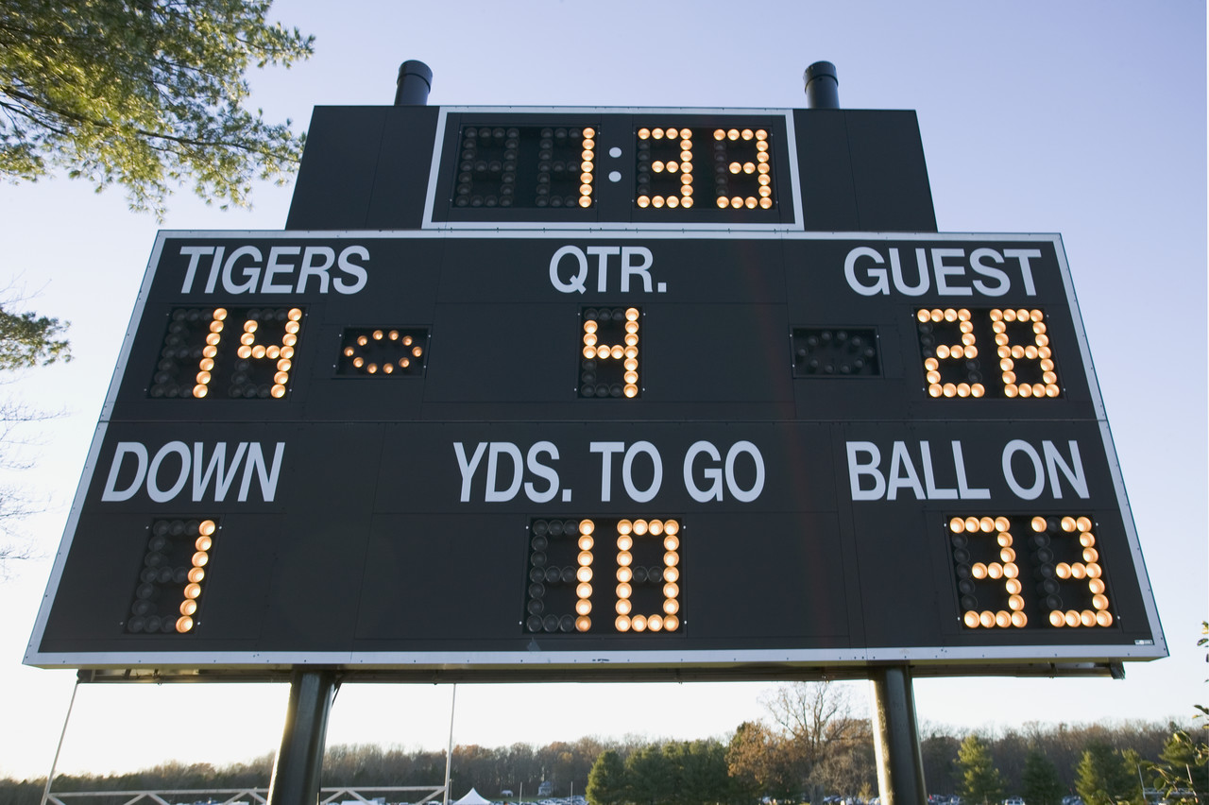
Unit 4: Game Day Procedures
COMMISSIONER’s GUIDE

Slide 54
GAME Commissioner
The Home Team’s Commissioner acts as the Game Commissioner.
The Game Commissioner is responsible for:
    conducting football weigh-ins and cheer check-ins
    maintaining control of the game, including crowd control (with assistance from visiting team Commissioner)
    submitting the Game Report and reporting the score of the game to CDPW

Slide 55
Pre-Game: Commissioner TASKS
Introduce yourself to the officials and head coaches; introduce them to each other.
Verify and identify who will be responsible for providing medical attention, if required.
Confirm that the ratio of participants to adult coaches is 12:1 for football and cheer squads.
Obtain 3 individuals (16+ yrs.) for down marker and yardage change. Visiting team should supply at least 1 person.
Check size of football(s) to be used:
  Mitey Mite →Mitey Mite
  Junior Pee Wee/Pee Wee → Junior
  Junior Varsity/Varsity → Youth

Slide 56
TACKLE Game Officials
  4 officials should be assigned.
    Game/Scrimmage may be played with 3 officials.
Home Team Game Commissioner must pay officials during halftime with an Association check.

Slide 57
Medical Coverage
Medical coverage during games and practices is the responsibility of the HOME Association.
Ranking of Medical Coverage:
  Physician
  Licensed physician’s assistant
  Nurse practitioner
  Paramedic
  Emergency medical technician (including EMT-FR)
  Certified multi-medical Red Cross card carrier or equivalent (nurses do not qualify unless they fall into one of the above categories)
When available coverage is equal rating, the home team coverage will prevail.

Slide 58
Pre-Game Weigh-In / Check-In
Only Game Commissioners may conduct weigh-ins / check-ins.
Team Books must be turned over to Game Commissioner for weigh-in/check-in one hour prior to scheduled start of game. Weigh-in / check-in must be completed within 15 minutes of kickoff.
A representative from the visiting team, preferably the Commissioner, must be present during weigh-in /check-in.
Coaches are only allowed in the weigh-in /check-in area for disciplinary reasons (at the discretion of the Game Commissioner).
Upon completion of weigh-in /check-in, Team Book is returned to team representative but shall be made available to the Game Commissioner at his/her request at any time during the game.

Slide 59
Pre-Game Weigh-In / Check-In (cont’d)
Home team is responsible for providing:
  an upright scale and a certified weight to check scale accuracy. A certified weight must be present or the game is forfeited.
  a suitable enclosure for pre-game weigh-in that provides adequate cover and is out of view of fans.
Weigh-in / check-in home team first.
Players should line up in jersey number order and state their name and jersey number out loud.
Check players’ helmets – achievement awards not allowed.
Once weighed /check-in, record date and player’s status; and your initials on ID card.
Once weigh-in / check-in is complete, no equipment may be exchanged.

Slide 60
Pre-Game Weigh-In / Check-In (cont’d)
Players will be weighed according to the Acceptable Method described in National Rule Book (full equipment without helmet).
  If a player fails to meet the weight requirement, they will be given an opportunity, after other players have been weighed, to be weighed using the Ideal Method (without equipment; in gym shorts/socks).
Pass / Fail limits
Weight allowances for equipment:
  MiteyMite: 7 lbs.; Jr. Peewee/Peewee: 8 lbs.; Jr. Midget/Midget: 9 lbs.
Weekly weight gain allowed: 1 lb. in weeks 2, 4, 6, & 8 (Max 4 lbs.) Additional 1 lb. at Super Bowl.
Decision of weigh master is final!

Slide 61
Pre-Game Weigh-In / Check-In (cont’d)
If players arrive late:
  less than 15 minutes before kickoff → cannot play first half
  during first half → weigh-in /check-in at half-time and may play second half
  after end of second quarter → not qualified to play

Slide 62
Pre-Game Check-In (Spirit Participants)
The cheer/dance squad Team Book(s) are to be turned over to the Game Commissioner prior to the start of game.
Immediately following the football players' weigh-in/check-in, the Game Commissioner will take attendance for spirit participants and initial each ID card.
Participants should line up in alphabetical order and state their name to the Game Commissioner.
If cheer/dance participants arrive late:
  not present at check-in → cannot cheer first half
  during first half → check-in at half-time and may cheer second half
  after end of second quarter → not qualified to cheer

Slide 63
Game Time:
Sportsmanship Statement
At all football games and cheer competitions, the NYS Public High School Athletic Association Statement on Sportsmanship (modified for Pop Warner) should be read over the loud speaker (if available) prior to the start of the game, or at the Official’s meeting at the 50-yard- line prior to the coin toss.
Sportsmanship Statement
The Capital District Pop Warner Football Federation requires officials to enforce all sportsmanlike rules for athletes and coaches. We will not tolerate negative statements or actions between opposing players, especially trash-talking, taunting or baiting of opponents. If such comments are heard or actions seen, a penalty will be assessed immediately. We have been instructed not to issue warnings. Let today’s contest reflect mutual respect.

Slide 64
Game Time Regulations: Field ID Tags
ONLY individuals on the official team roster OR with the appropriate field identification tags are allowed on the field of play.
The following individuals will receive ID Tags for CDPW
  CDPW Board Members
  Association Presidents
  Football Team Head Coaches
  Spirit Head Coaches
  Team Commissioners

Slide 65
Game Time Regulations
The home team shall supply a fence, rope or other restraining device to keep spectators a minimum of ten yards (10) from the playing field.
A maximum of ten (10) rostered team personnel may be inside the 25-yard markers and within coaches’ box.
  1 Head Coach, 5 Assts., 1 Coach Trainee, 1 Commissioner, 1 equipment manager, and 1 certified trainer.) All others must stay behind the restraining device, except for the pre-game identified medical person.
Cheer/dance participants may be within five (5) yards of the playing field, but may not be within the 25-yard markers.
  Exception: field has suitable space behind the football player’s bench, such as a running track around the field. However, squad may NOT be inside the football player’s “box.”

Slide 66
Game TIME Regulations (Cont’d)
No radios or other communicative devices, including cell phones, are allowed during game situations to relay information to the coaching staff on the sidelines.
Games may be videotaped but cannot be shown at halftime.
Sideline officials (statisticians, spotters, chain crew) should refrain from cheering, etc.
Once a game has started, only the head official can call the game off.
A Game Commissioner cannot call a time out but may request a time out from the head coach in order to talk to the referee if there is a circumstance pending on the field.

Slide 67
Minimum Player Rule
A minimum of 16 tackle players (10 for Flag) dressed and eligible for play are required to start a game; you may finish a game with 15 players.
If the count of eligible players falls below 15 (10 for Flag), the game will immediately be suspended.
The CDPW Commissioner should be notified immediately, and a continuation game will be played on the following Wednesday night.
  All players who were eligible to play at the start of the suspended game will be allowed to play in the continuation game.
If a game is suspended for any other reason, (inclement weather, etc.), the game will also be continued on the following Wednesday night.
  Only players eligible to play at the time the game was suspended will be allowed to play in the continuation game.

Slide 68
Minimum Play Requirement (MPR)
Coaches shall follow the MPR rule (based on # of eligible players at time of game):
  16 – 25 players → 10 plays (12 for Mitey Mite)
  26 – 30 players → 8 plays (10 for Mitey Mite)
  31 – 35 players → 6 plays (8 for Mitey Mite)
  Flag → All players receive 10 plays
MPR must be met for all players by the end of the 3rd quarter – otherwise, player(s) must enter the game at the start of the 4th quarter and remain in game until MPR is met.

Slide 69
What plays count toward MPR?
The plays must be from the line of scrimmage.
All players shall be provided their mandatory plays by participation in “active” plays, without the intent to minimize the action or integrity of the plays.
Plays such as, but not limited to, having the center snap the ball to the quarterback, and then the quarterback fall to the ground, while substitutes are playing the other positions, shall NOT be considered as active plays.
The following do not count toward MPR:
  Kickoffs, extra points, and free kicks
  Plays that result in a penalty which causes the down to be replayed
  QB takes a knee or intentionally spikes the ball

Slide 70
FaILURE TO Adhere to MPR
Failure to adhere to MPR requirements will result in:
  Minimum fine of $200 plus forfeiture of game.
  The Coach will receive probation for one year
    If violation found to be intentional, coach will also be suspended from games/practices for 1 week.
  A player denied his required number of plays will start the next game and receive double the number of mandatory plays in that game. Failure to comply with this provision will be deemed a second violation.

Slide 71
MPR: Statisticians
Each team will provide at game time a numerically listed statistician form including starting offense and defense, and player’s jersey number.
Home team statistician records minimum plays for the visiting team on the visitor side of the field. Visiting team statistician records the minimum plays for the home team players on the home side of the field. There should be a spotter for each statistician.
At half-time, Game Commissioner should request the statistician count of players who have not completed their MPR and inform the respective head coach. Repeat at the end of the 3rd quarter (if necessary).
Notify each head coach when all of his players have completed the minimum play requirements.
Statistician must sign and date the Statistician Form.

Slide 72
Mandatory Play Roster (Statistician Form)

Slide 73
Lopsided/Intentionally Run Up Scores
“28 Point Rule”
Any time a team goes up by 28 points, the following will occur:
Official clock becomes a running clock immediately when the 28th point is scored. Once started, the clock can only be stopped for injury of a player and cannot revert to a game clock operation for the remainder of the game.
The winning team cannot pass the ball or run sweeps outside the tackle. If the winning team fails to abide by this rule, each violation will be a loss of down and a 5-yard penalty. This is at the discretion of the game referee.
There will be no blitzing by either team.
There will be no onside kicks at kickoff by the winning team.
The winning defense team cannot advance a fumble or pass interception. The ball is blown dead immediately. The winning offense may start play action from this point.

Slide 74
28 Point Rule (Cont’d)
The losing Team’s Defense:
  Must use either a 4-3 or a 3-4 defense with linebacker set at least 5 yards off the line of scrimmage and defensive backs at least 10 yards off the line of scrimmage.
  Must cover all split receivers/wide outs man for man
The winning team must make every effort to replace starting players with reserves. Failure to do so will call for an immediate investigation and possible one game suspension if found guilty.
Any coach who employs types of plays without the intent to maximize the action of play shall be in violation of this rule.
The teams are still required to complete the mandatory play rule.
An investigation will be conducted any time a game ends with a score differential of 28 points or more.

Slide 75
OTHER Game time Rules
Clipping is illegal anywhere on the field including free-blocking zone.
No kickoffs for Mitey-Mites and Jr. PeeWees. To start the game or the 2nd half, or after TD, field goal or safety, the ball will be placed on the 35 yard line.

Slide 76
Tie Ball Games
In the event a game ends in a tie, the National Federation of State High School Associations shall govern the tiebreaker:
  4 downs from the 10 yard line
NO GAMES will end in a tie (except Mitey Mite)

Slide 77
Player Ejection
If a player or spirit participant is ejected from a game, ejection MUST be noted on the Game Report.
Ejected child shall be ineligible for participation at next game.
If the child is ejected from a second game (same season), child will be ineligible for remainder of season.

Slide 78
Post-GAme: Game Report
The Game Commissioner is responsible for completing the Game Report and submitting it to CDPW. The Game Report should include:
  Names of Coaches, Commissioners, Officials, Statisticians, and present medical personnel
  Game score by quarters (not a running score) and a final score (including Mitey Mite).
  Any remarks from Coaches, Commissioners, or Officials involving character of the game, players, and coaches.
  Record of all injuries, disciplinary actions, game violations and/or suspected game violations.
  Any incidents involving cheer/dance participants.
  Home and Visiting Team Commissioners must sign the COMPLETED game report acknowledging all comments (even though they may not agree with the content).

Slide 79
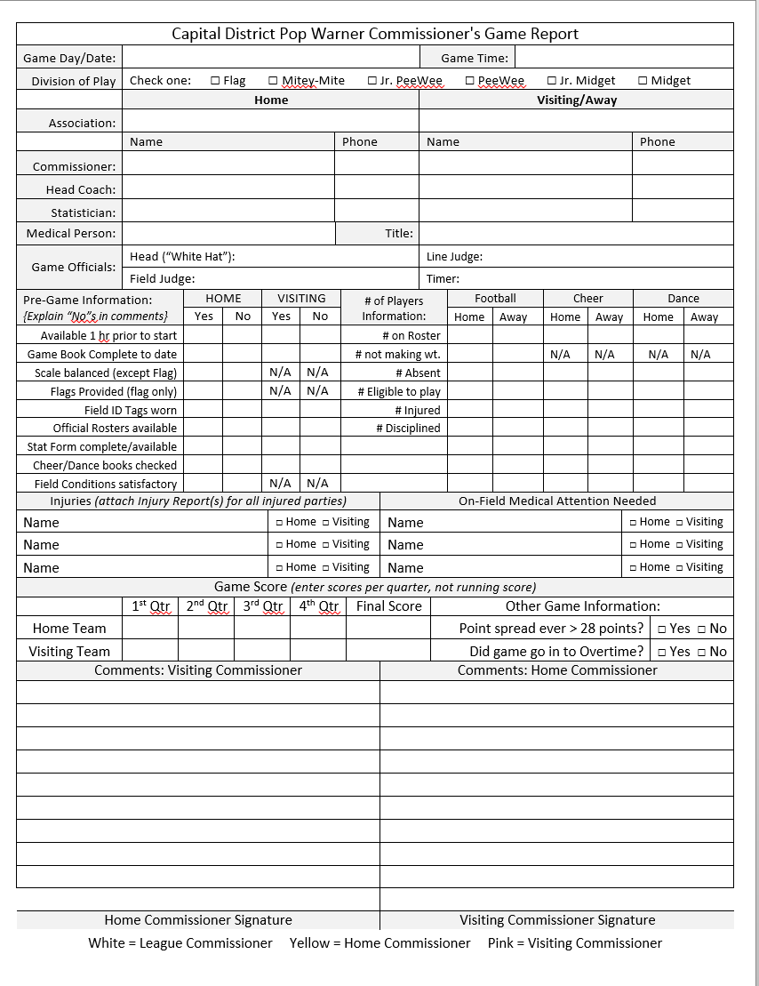

Slide 80
SPECIAL NOTE FOR MITEY-MITES
CDPW Coaches are allowed on the field during the first TWO (2) WEEKS of the season.
A maximum of one (1) coach per team is permitted on the field except during punts.
There shall be no blitzing, no rushing of: punts, field goals or point after touchdown (while attempting a kick) in Mitey-Mite play.

Slide 81
SPECIAL NOTE FOR MITEY-MITES (cont’d)
Mitey Mite teams are only permitted to play (2) post-season games in their own or an adjacent league/conference (excluding Mitey Mite National Invitation Bowl Games).
This allows for replacing one Regular Season Mitey Mite Game with a second Post Season Bowl game. It also allows overnight travel to an adjacent league/conference.

Slide 82
YCADA GLOBALS

Slide 83
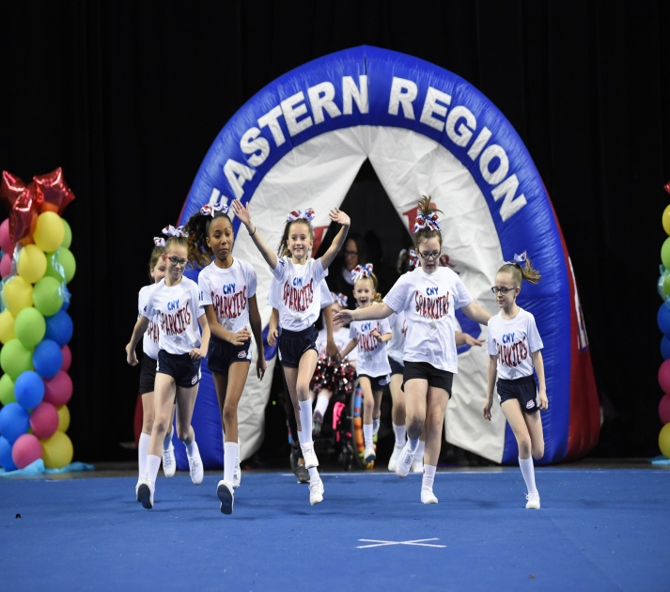
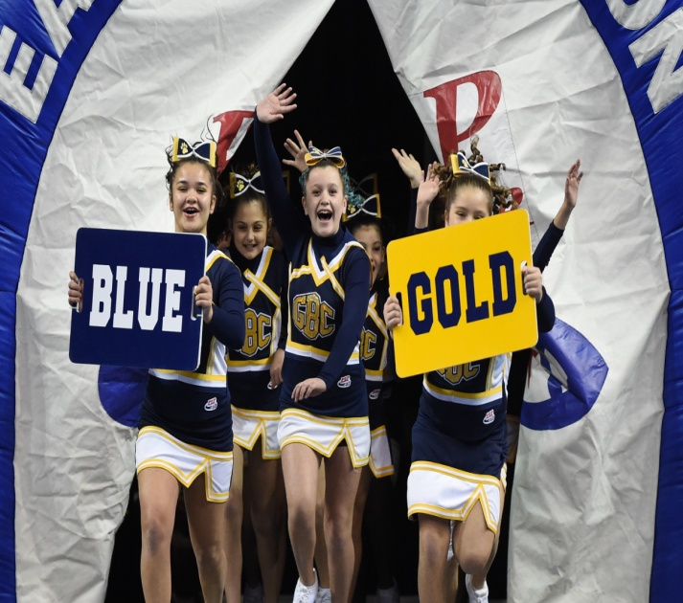
CURE INSURANCE ARENA
TRENTON, NEW JERSEY

Slide 84
Unit 5: Keeping Youth Sports Fun
Coaches’ and Parents’ behavior

Slide 85
How to keep Young Athletes involved
Emphasize learning new skills and improving existing ones. Let the athletes be proud of all they are learning about the sport.
Have Fun. Be positive and have fun yourself!
Maintain a safe environment, both physically and emotionally. Do not allow participants to ridicule each other.
Challenge Athletes with Physical Exercises in a Creative Way. Use relay races and challenges to do conditioning.
Give participants a Sense of Belonging to a Team. Consider a team slogan or team shirts.

Slide 86
Use Effective Feedback
Positive feedback is key. Research shows that the most effective teachers use 5 times as many positive statements as they do negative statements.
  Catch athletes doing things correctly.
  Be specific & concise.
  Focus on strengths more than weaknesses.
  Give feedback promptly and immediately.
  Be sincere when giving praise.
  Reward improvements, not perfection.
  Reward effort as well as outcome.
  Avoid being insulting and negative.

Slide 87
Coach and Parent Misconduct
Pop Warner has become increasingly concerned about the numbers of incidents of parental violence and misbehavior of coaches.
The newspapers and TV are full of stories about youth coaches and parents ruining youth sports for the kids.
Your Association MUST have a zero tolerance for aggressive, disruptive, abusive, and disrespectful behavior.
CDPW will assist your Association in dealing with problem behaviors and disruptive individuals.

Slide 88
Coach & Parent Misconduct (cont’d)
It is the responsibility of each team to maintain spectator and coaching staff control during games. The Game Commissioner may ask the officials to penalize the team that fails to maintain control after one (1) warning.
Failure to maintain spectator and/or coaching staff control in pre-game, game and post-game situations could lead to an extreme penalty such as game forfeiture.
In the event an adult volunteer is ejected from a game, it must be noted on the Game Report and the ejected volunteer will receive an automatic one (1) week suspension (including all practices and the following game).

Slide 89
PWLS Members Code of Conduct
Please read through each of these items.
Please fill out the bottom completely and submit before you leave today.

Slide 90
Visit Us Online
National Website:
www.popwarner.com
Eastern Region:
www.easternregion.org
League Web Site:
www.cdpopwarner.com

Slide 91
ANY Questions?

