Slide 1


Capital District Pop Warner Education Program
For Coaches, Commissioners, and other volunteers

Slide 2
CDPW Volunteer Training
This Training is for all Presidents, Commissioners, Cheer/Football Coordinators, and Coaches.
  Coaches are responsible for managing the team/squad.
  Commissioners are responsible for administrating the game and rules.
  EVERYONE is responsible for following the rules!
As a volunteer, it is your responsibility to support the goals and philosophies of the Pop Warner program.

Slide 3
Other Clinics/trainings - Football
Coaches: USA Football/Heads Up Online Training (USAFOOTBALL.COM)
Tackle: Mandatory for ALL Head and Assistant Coaches
Flag: Mandatory for Head + all assts.
Certificates must be in Team Book behind coach ID Card and uploaded into affinity
$15.00; must complete by August 1st; valid for year
CDPW Flag Coaches Clinic (TBD)
8U Coaches Clinic (TBD)

Slide 4
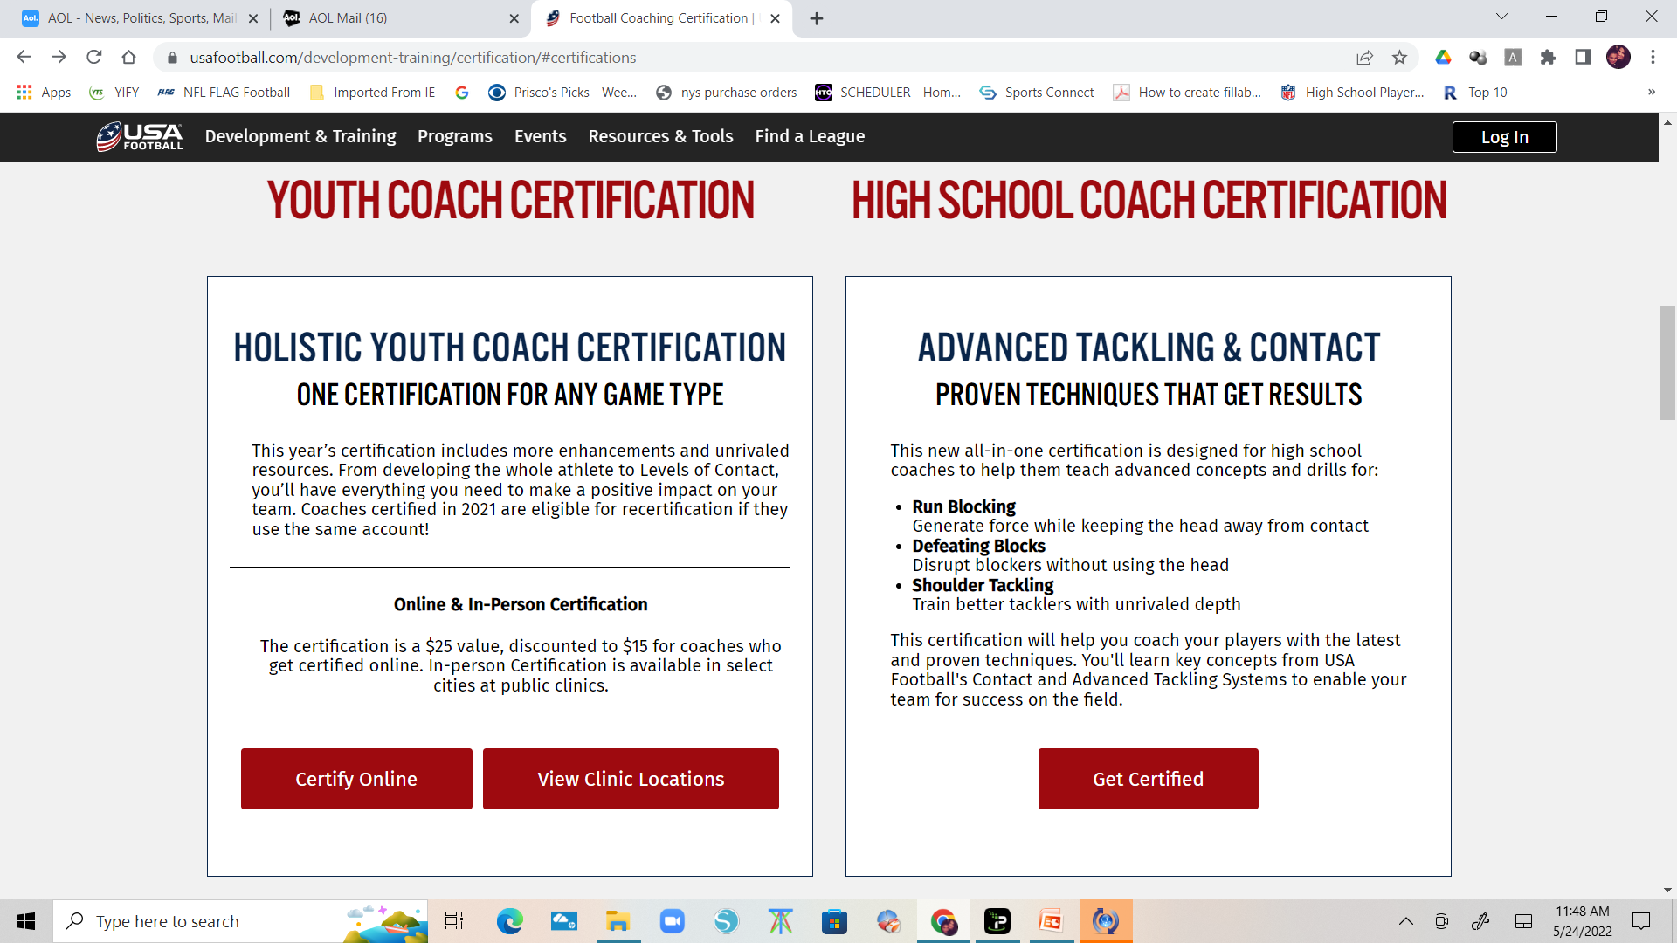
Other Clinics/trainings - Football

Slide 5
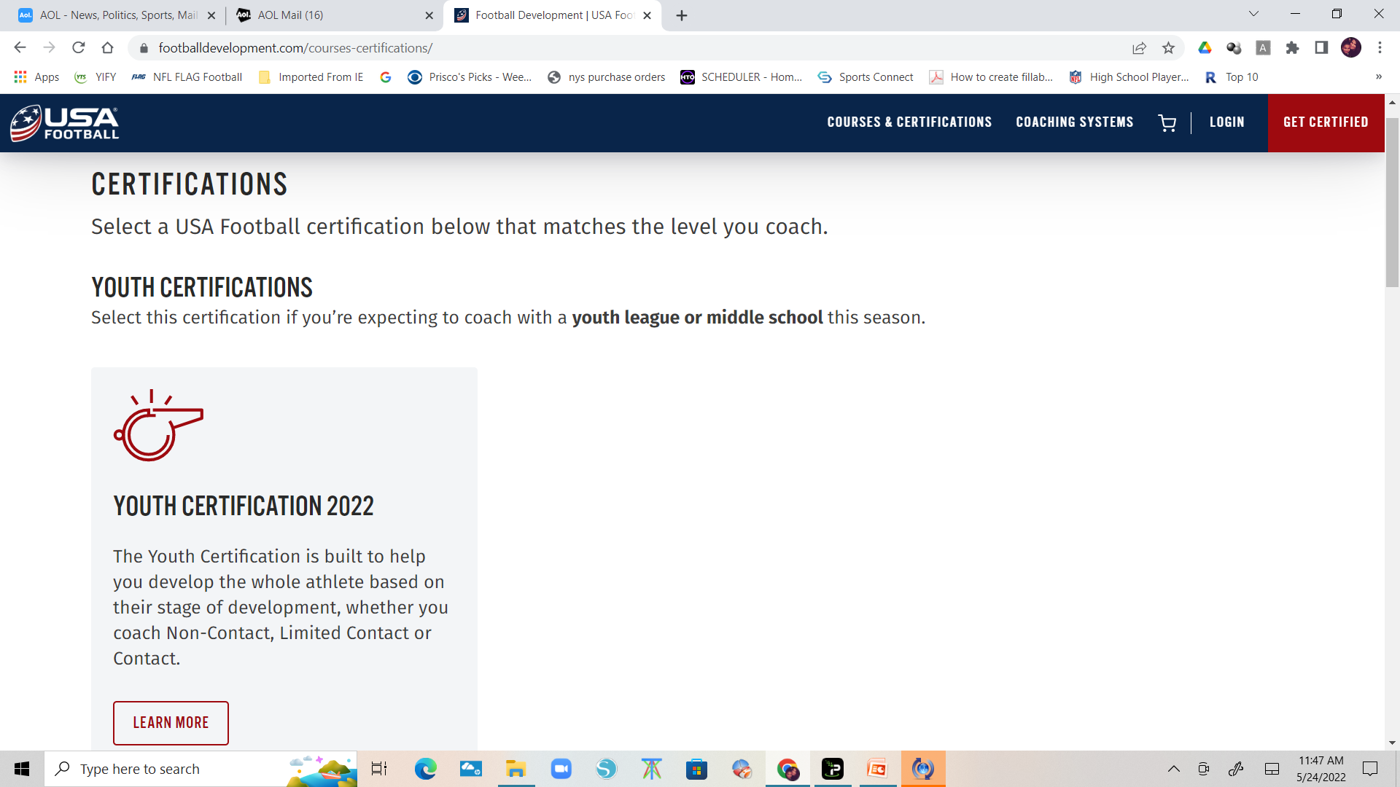
Other Clinics/trainings - Football
The full Youth Coach Certification is currently a 3 hour course.
The recertification will take 30-90 minutes, depending on what a coach completed last year.

Slide 6
Other Clinics/trainings - Cheer
YCADA Coaches Course (https://shop.ycada.org/courses)
  Mandatory for ALL on roster (Head/Asst./Jr. Coaches, Cheer Coordinator, Team Parents, etc.)
  Must complete Y101PW $25 by Aug. 1- Valid for 2 years
  must be in Team Book and uploaded to affinity.
YCADA’s Competitive Edge (https://shop.ycada.org/courses)
  Recommended for Coordinators/Coaches
  Cost $30.00

Slide 7
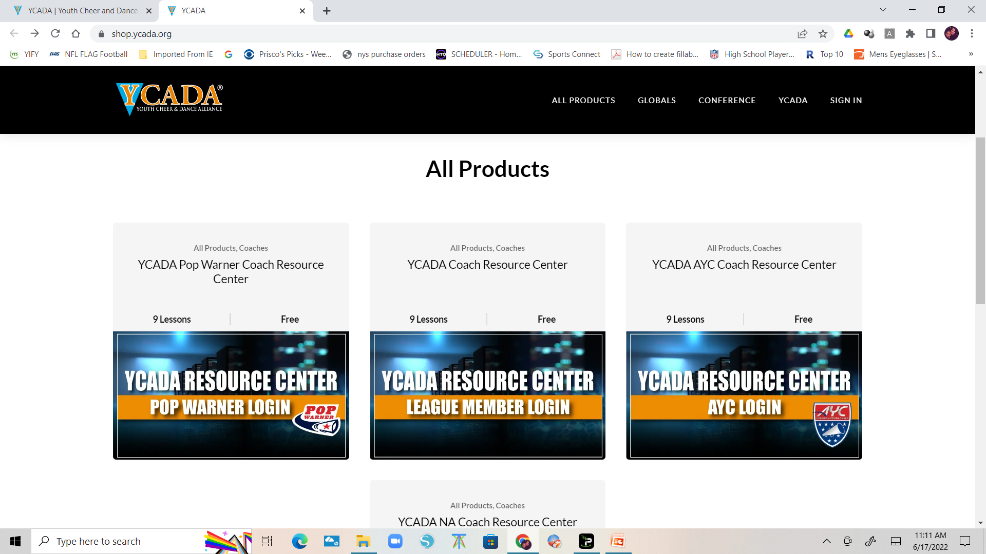
Other Clinics/trainings - Cheer
Y101PW - For first time coaches
Y102PW - Refresher Course - Taken the year after Y101PW
(We sent email invites to all eligible coaches. If you didn't receive yours, check your spam folder or contact support@ycada.org)
Y103PW - Recertification Course - Taken the year after Y102PW
Y201 - Coach's Competitive Edge (Optional) - Take your team to the next level! Learn how to score higher and avoid deductions this season.
All coaches who took the Y101PW2021 course must take the Y102PW2022 Refresher Course for the 2022 season.

Slide 8
AGENDA
Unit 1: Pop Warner Overview
Unit 2: Your Association
Unit 3: Risk Management
Unit 4: Game Day Procedures
Unit 5: Keeping Youth Sports Fun
Closing Remarks and Questions

Slide 9


UNIT 1: Pop Warner Overview
History, Philosophy, Structure

Slide 10
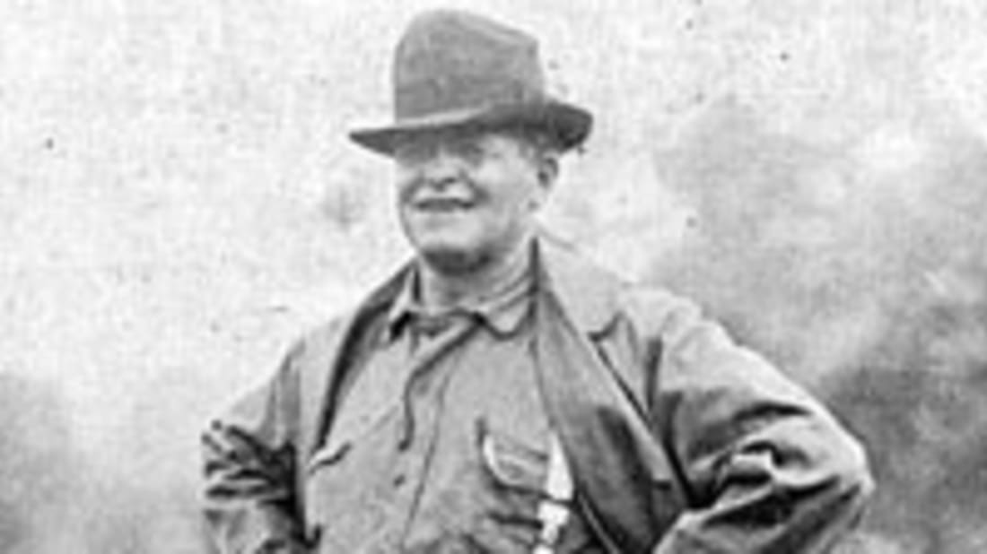
History of Pop Warner
1934: College coaches were invited to speak at a clinic for the Junior Football Conference (JFC). Bad weather kept away all but one - Glenn Scobie "Pop" Warner from Temple University. He spoke with the players for two hours -- by the end of the evening, the program was renamed the Pop Warner Conference.

Slide 11
History of Pop Warner
1959: Pop Warner Little Scholars (PWLS) was incorporated as a national non-profit organization. The name was selected to emphasize that the classroom is as important as the playing field.
1970: Pop Warner Football (formally for boys only) introduce cheerleading as a new Pop Warner branch.
Today: PWLS is the largest youth football, cheer and dance program in the world with 325,000 participants in 42 states and several countries. It is the only national youth sports organization that requires its participants to maintain academic standards in order to participate.

Slide 12
Pop Warner Mission
Pop Warner seeks to:
Provide fun athletic learning opportunities, while emphasizing the importance of academic success.
Familiarize players and spirit participants with the fundamentals of football, cheerleading and dance.
Inspire youth, regardless of race, religious belief or national origin, to practice the ideals of sportsmanship, scholarship and physical fitness as reflected in the life of the late Glenn Scobie “Pop” Warner.

Slide 13
Organizational STRUCTURE
National Pop Warner Little Scholars, Inc.
Executive Director: Jon Butler
REGION: Eastern
Region Director: Harry Harrington
LEAGUE: Capital District
President: Dan Martuscello
ASSOCIATION: ex: Albany

Slide 14
CDPW Board of Directors
Dan Martuscello
President
Don Delong
1st Vice-President (Football)
Yvonne Cleveland
2nd Vice-President (Cheer)
Tom Hindes
Treasurer & Challenger Commissioner
Judi Byrnes
Secretary / Little Scholars
Pamela Mason
Flag Commissioner
Jon Myers
8u Commissioner
Heather Mantica
10u Commissioner
Don DeLong
12u Commissioner
Shawn Hawkins
Webmaster

Slide 15
CDPW Associations
Albany
Ballston Spa
Bethlehem
Clifton Park
Cohoes
Colonie
East Greenbush
Greene County
Guilderland
No. Columbia County
Ravena
Rensselaer
Rotterdam
Saratoga
Schenenectady-Belmont
So. Glens Falls
South Troy
Troy

Slide 16
Unit 2: Your Association
Your Board, Coaches, and Teams

Slide 17
Association Board of Directors
Should Include…
May Include…
  President
  Vice President
  Secretary
  Treasurer
  Football Coordinator
  Cheerleading Coordinator
  Scholastic Coordinator
  Registration
  Fundraising Chair
  Concession Stand Manager
  Equipment Manager
  Any other positions that will help your Association to run efficiently
All Board Members should attend monthly meetings to receive information so that your association members stay well-informed.

Slide 18
Background Checks
Annual Background Checks must be conducted on any persons who provide regular service to your Association and/or have repetitive access to, or contact with participants (e.g. Board of Directors, Coaches, Medics, Commissioners, and any other adults that appear on a team roster).
Each Individual completes the PWLS Volunteer Application and submits to your Association.
Association submits the PWLS Association Affidavit, along with a list of those checked, to CDPW before August 1st.
PWLS Volunteer Application and Affidavit Form can be found on our website www.cdpopwarner.com under Forms

Slide 19
Football Coaching Staff
A maximum of ten (10) staff positions:
  1 Head Coach (age 21 +)
  5 Assistant Coaches (age 18+)
  1 Coach Trainee (age 16-17)
  1 Equipment Manager
  1 Trainer
  1 Commissioner
Only these rostered staff and others with CDPW Field ID Tag are allowed on the field.
Ratio of children to coaches (age 21+) must be 12:1 at all events (practices, games, etc.).
Notes:
Neville’s Slide

Slide 20
Football Formation of Teams:
Alpha Splitting
If there are multiple teams in same Division, participants must be divided equally and alphabetically by last name:
  “A” team (1st half of alphabet)- American Conference
  “B” team (2nd half of alphabet) - National Conference
  If needed, “C” team - players divided equally in thirds
Team splitting must occur after first 10 hrs of team practice.
Exceptions:
  Flag Football - equal distribution of 5, 6, & 7 year olds
  Coach & child/family members may remain together
Notes:
Neville’s Slide

Slide 21
Football Eligibility
A football player will be considered ineligible due to:
Participation in school tackle football program or any other non-affiliated football program and Pop Warner Football at the same time.

Slide 22
Cheer Coaching Staff
A maximum of (9) staff positions:
  1 Head Coach (age 21 +)
  4 Assistant Coaches (age 18+)
  Max of 4 Student Demonstrators/Coach Trainees Combined
    Maximum of 3 Coach Trainees (ages 16-17)
    Maximum of 4 Student Demonstrators (ages 15-17)
      Student Demos may be 14 ONLY IF rostered on H.S. team
Only these rostered staff and others with CDPW Field ID Tag are allowed on the field.
Ratio of children to coaches (age 21+) must be 12:1 at all events (practices, games, competitions).
Notes:
Neville’s Slide

Slide 23
Cheer Coach Trainees &
Student Demonstrators
Certified on roster like a spirit participant
  Must submit Birth Certificate, Physical Form, Report Card, etc.
Must be at least 2 years older than oldest child on the squad.
Must have at least 2 years Cheer/Dance experience.
May only teach cheers and demonstrate moves: no hands-on coaching
Notes:
Neville’s Slide

Slide 24
Cheer - Formation of Squads
Sizes: Small (5-10), Medium (11-20), Large (21-35)
When there are multiple teams/squads for the same division, they are split alphabetically, unless squads are different levels (i.e. PW2, PW3, etc.).
Squads must be attached to a football team, unless Association doesn’t have football program.
Mascots are only allowed if there is no Cub Squad.
  Must be 5+ years of age; maximum of 2 per squad
  May not perform stunts; can not perform at competition
Notes:
Neville’s Slide

Slide 25
Cheer Eligibility
Participants may individually enroll in non-Pop Warner affiliated instructional classes. However, Pop Warner cheer participants may not be officially enrolled in cheer or dance team that is not a School affiliated program.
All-Star and other Recreational cheer and dance team participation is not permitted during the Pop Warner Season.

Slide 26
Practice Guidelines
BEFORE LABOR DAY
Up to 10 hours of practice per week
Not more than 2-1/2 hours on any one day
These limits apply to Year-Round Cheer, 1/1-7/31
AFTER LABOR DAY
Up to 6 hours of practice per week
Not more than 2 hours on any one day
Note:
A week is defined as 7 consecutive days.
Break time is not counted against allowed practice time.
Cheer is allowed an additional 2 hours a week if declared a cheer and dance squad

Slide 27
Contact Limits
  Prior to Labor Day:
  contact is limited to
  a max of 30 min/day
  and 120 min/week;
  After Labor Day:
  contact is limited to
  a max of 22 min/day
  and 65 min/ week
  “Contact”
  drill or scrimmage in which players go full-speed with contact, (e.g. one-on-one blocking and/or tackling drills; down line vs. down line full-speed drills; and/ or scrimmages)

Slide 28
CONTACT
NO FULL SPEED HEAD ON BLOCKING OR TACKLING DRILLS IN WICH THE PLAYERS LINE UP MORE THAN 3 YARDS APART ARE PERMITTED
You may have full speed drills where players approach each other at an angle ,but not straight ahead into each other .

Slide 29
Practice Guidelines
Cheer
After the first TWO weeks of practice (10 hours) for conditioning each week, perform readiness evaluation, then the squad may engage in regular practice sessions and/or pre-season games.

Slide 30
TEAM BOOK: Contents
CDPW Commissioner’s Game Guide
Sportsmanship Statement Card
Team Documentation
  Team Roster
  Cheer Only: Skill Progressions and Declaration Checklist
  Head Coach ID card and Online Training Certificate
  Assistant Coach(es) ID Card(s) and Online Training Certificate(s)
  Participant Documentation
Notes:
30

Slide 31
Participant Documentation
The following documentation is required for every Participant and Coach Trainee/Student Demonstrator :
  ID Card with picture attached
  Coach Trainees’/Student Demonstrators’ YCADA Online Certificates Cheer only
  Copy of Birth certificate
  Physical Fitness/Medical History Form
  Participant Contract/Parental Consent Form
  June Report Card

Slide 32
Team BOOK: Order of Participants
Team Books should be completely assembled for CDPW
Book Certification in August. Once the season starts,
the football participant order CHANGES.
Football
  Book Certification – Alphabetically
  In-season – By Jersey #
Cheer
  Book Certification & In-Season – Alphabetically
  Coach Trainees/Student Demonstrators with Online
  Training Certificate(s) first, then all other participants
  October 1st: Roster Freeze Period (rosters and applications are locked in for the season)

Slide 33
BE AWARE WE ARE GOING DIGITAL

Slide 34
NEW THIS YEAR
All player photos will need to be uploaded
All coaches and junior coaches photos and certificates will need to be uploaded
THIS MUST BE DONE TO APPROVE ROSTER

Slide 35
UNIT 3: Risk Management
Know the Rules to Minimize Risk

Slide 36
Risk Management
Pop Warner Coaches Risk Management Handbook:
(can be found on cdpopwarner.com under forms)
  Provides valuable information on how to manage your team to minimize risk of injury to athletes and risk of liability to yourself

Slide 37
PWLS COACHES Risk Management Handbook
Properly plan activities
Provide appropriate supervision
Provide proper instruction
Provide adequate and proper equipment
Evaluate for injury or incapacity
Provide safe physical environment
Match athletes accordingly
Warn of inherent dangers
Initiate medical response

Slide 38
A. Properly Plan Activities
Plan practice activities in advance. Document the time spent and the techniques taught.
  Documentation ensures proper procedures are followed and aids in your defense in the case of alleged negligence.
  Advance planning results in more organized and effective practices with fewer accidents.

Slide 39
Properly Plan Activities (Cont’d)
Incorporate the following elements into practices and games/competitions to ensure that athletes avoid injury:
Warm-up
(10 minutes) and cool-down (10 minutes)
  No more than 30 minutes of warm-up before games and competitions
Training
  The training methods , frequency, duration, and intensity of practices should vary among athletes based on age, experience, physical conditioning, mental state, and training goals.
  The purpose of training is to prepare for competition – it is NOT to be used as a disciplinary activity, or competition itself.

Slide 40
Properly Plan Activities (Cont’d)
An effective practice includes:
  Practicing previously taught skills
  Teaching and practicing new skills
  Practicing under competitive conditions
  Discussing things that need improvement, were successful, or need to be eliminated

Slide 41
B. Provide Appropriate Supervision
Coaches are responsible for providing appropriate supervision to prevent unnecessary risk of injury.
There are two types of supervision:
  General: oversight of all areas and events taking place during the session, whether training or competition.
  Specific: oversight of specific elements or skills being performed.

Slide 42
Provide appropriate supervision (Cont’d)
A coach’s supervisory responsibilities start when the first athlete arrives and do not end until the last athlete leaves.
Coaches should avoid any situation where a single coach is alone with one or more minors.
  Coaches are responsible for setting the standard of behavior for the team/squad. Additionally, it is the Head Coach’s responsibility to control the actions and attitudes of the athletes, coaching staff and parents.
  Appropriate behavior according to the Coaches Code of Conduct.

Slide 43
C. Provide Proper Instruction
Coaches are responsible for instructing athletes on sport-specific techniques and skills, game rules, safety rules, and sportsmanship.
  Introduce the Skill
  Demonstrate the Skill
  Explain the Skill
  Pay specific attention to athletes Practicing the Skill
It is your responsibility to improve your coaching skills by taking classes, reading books, going to clinics, etc. That will allow you to give proper instructions on technique.
Do NOT attempt to teach skills that YOU DO NOT
know or understand.

Slide 44
D. Provide Adequate & proper Equipment
Equipment must be:
Inspected prior to each practice and game
High quality and in good condition
Sized properly and fitted correctly
Maintained and repaired/replaced when damaged
Coaches should never modify equipment without consulting with and obtaining written consent from the manufacturer. Any modifications to equipment may void equipment warranties and create liability.

Slide 45
E. Evaluate for Injury and Incapacity
Sports injury care consists of two basic elements:
Prevention: Coaches should incorporate methods for preventing injuries and illnesses in their coaching programs including pre participation screening, strength training, conditioning, and awareness of the nature, cause, and mechanisms of sport specific injuries.
Recognition and Treatment: Once the coach realizes that an injury or illness has occurred, the magnitude must be assessed and appropriate care initiated.
Forcing ill or injured athletes to participate
is not acceptable!

Slide 46
Evaluate for injury and incapacity
Follow Return-to-Play Guidelines
If removed from game due to injury, participant must sit out at least one down, and may not re-enter game without approval of attending medical personnel.
When in doubt, play it safe!

Slide 47
F. Provide Safe Physical Environment
Coaches are responsible for inspecting all areas to be utilized in practice and competition to identify hazards.
Coaches should document their facility inspections – this can be beneficial in defending against certain lawsuits.
It is not sufficient to simply identify a hazard. You should take action by having the item corrected, posting warning signs, and/or keeping athletes/spectators away from the hazard.

Slide 48
INCLEMENT WEATHER
Monitoring weather conditions is the responsibility of the Game Officials, Coaches, Association and League Commissioners.
Prior to a game, Coaches and Officials should discuss the procedures they will follow in case of inclement weather.
If lightning is within 5 miles, (i.e. 30 seconds or less between lightning and thunder), the game should be suspended and shelter sought. Games should not be restarted for at least 30 min. after last roll of thunder is heard.

Slide 49
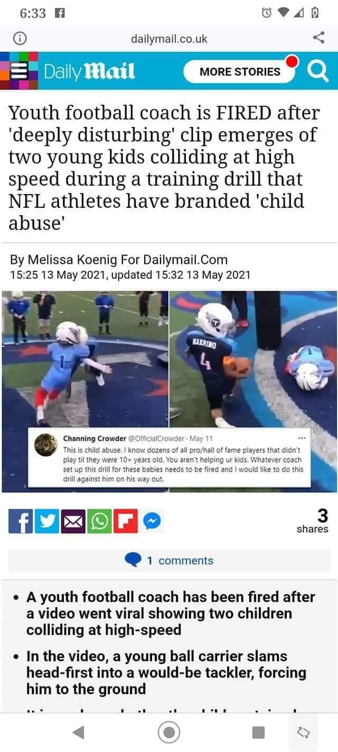
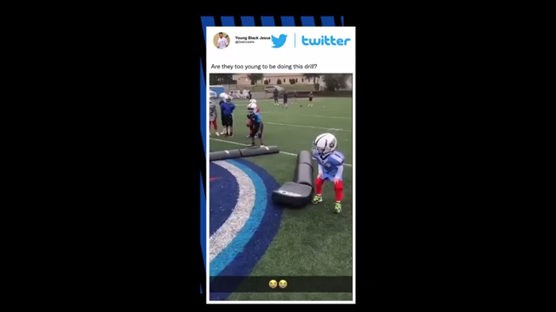

Slide 50
G. Match Athletes Accordingly
Coaches have a duty to match athletes at a similar competitive level to reduce the risk of injury and avoid unfair competitive advantage.
Skill, experience, height, weight, age, injuries, maturity, mental state and gender ALL must be considered when matching participants.
Numerous court cases have arisen out of the failure of a sports organization to appropriately match the size, age and skill of athletes.

Slide 51
H. Warn of Inherent dangers
Consider an Orientation Meeting to discuss:
  Risks involved with the sport and what injuries may occur
  Injury prevention measures that are used at games/practices.
  Importance of using, inspecting and maintaining proper equipment
  Emergency procedures that will be used

Slide 52
I. INITIATE MEDICAL RESPONSE
At ALL practices & games/competitions there MUST be:
  At least one coach or medic, certified in basic first aid/CPR
  First Aid Kit (see Risk Management Handbook for content suggestions)
  Team Book so medical and contact information is readily available
Purpose of First Aid it to stabilize the situation to prevent it from worsening until a doctor can provide further treatment – do not exceed the scope of your training!

Slide 53
Emergency Medical Plan
All Associations must create an Emergency Medical Plan
  Plan should be in writing and readily available
  Plan should be reviewed with staff, participants, and parents
Plan should include who will:
  Attend to the injured athlete
  Supervise other participants
  Call 9-1-1
  Retrieve Medical/Contact Information from the Team Book
  Notify the parents if they are not present
  Document the incident
  Etc. (see Risk Management Handbook)

Slide 54
Basic Duties of First Aid
Check the scene for safety
Check the injured athlete and protect from further harm.
Following universal precautions when appropriate (e.g. latex gloves)and properly dispose of all materials.
All bleeding must be stopped before returning to practice/game.
DO NOT MOVE THE ATHLETE
Activate your “Emergency Medical Plan”
Care for the injured athlete until EMS arrives

Slide 55
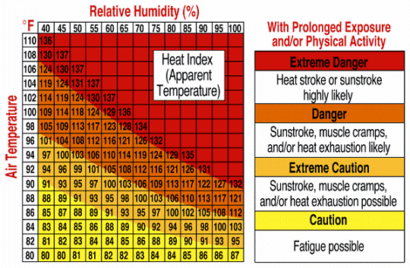
Heat-Related Emergencies
Can be avoided by
Canceling practice in extreme weather (high temperature and/or high humidity)
By taking frequent water breaks

Slide 56
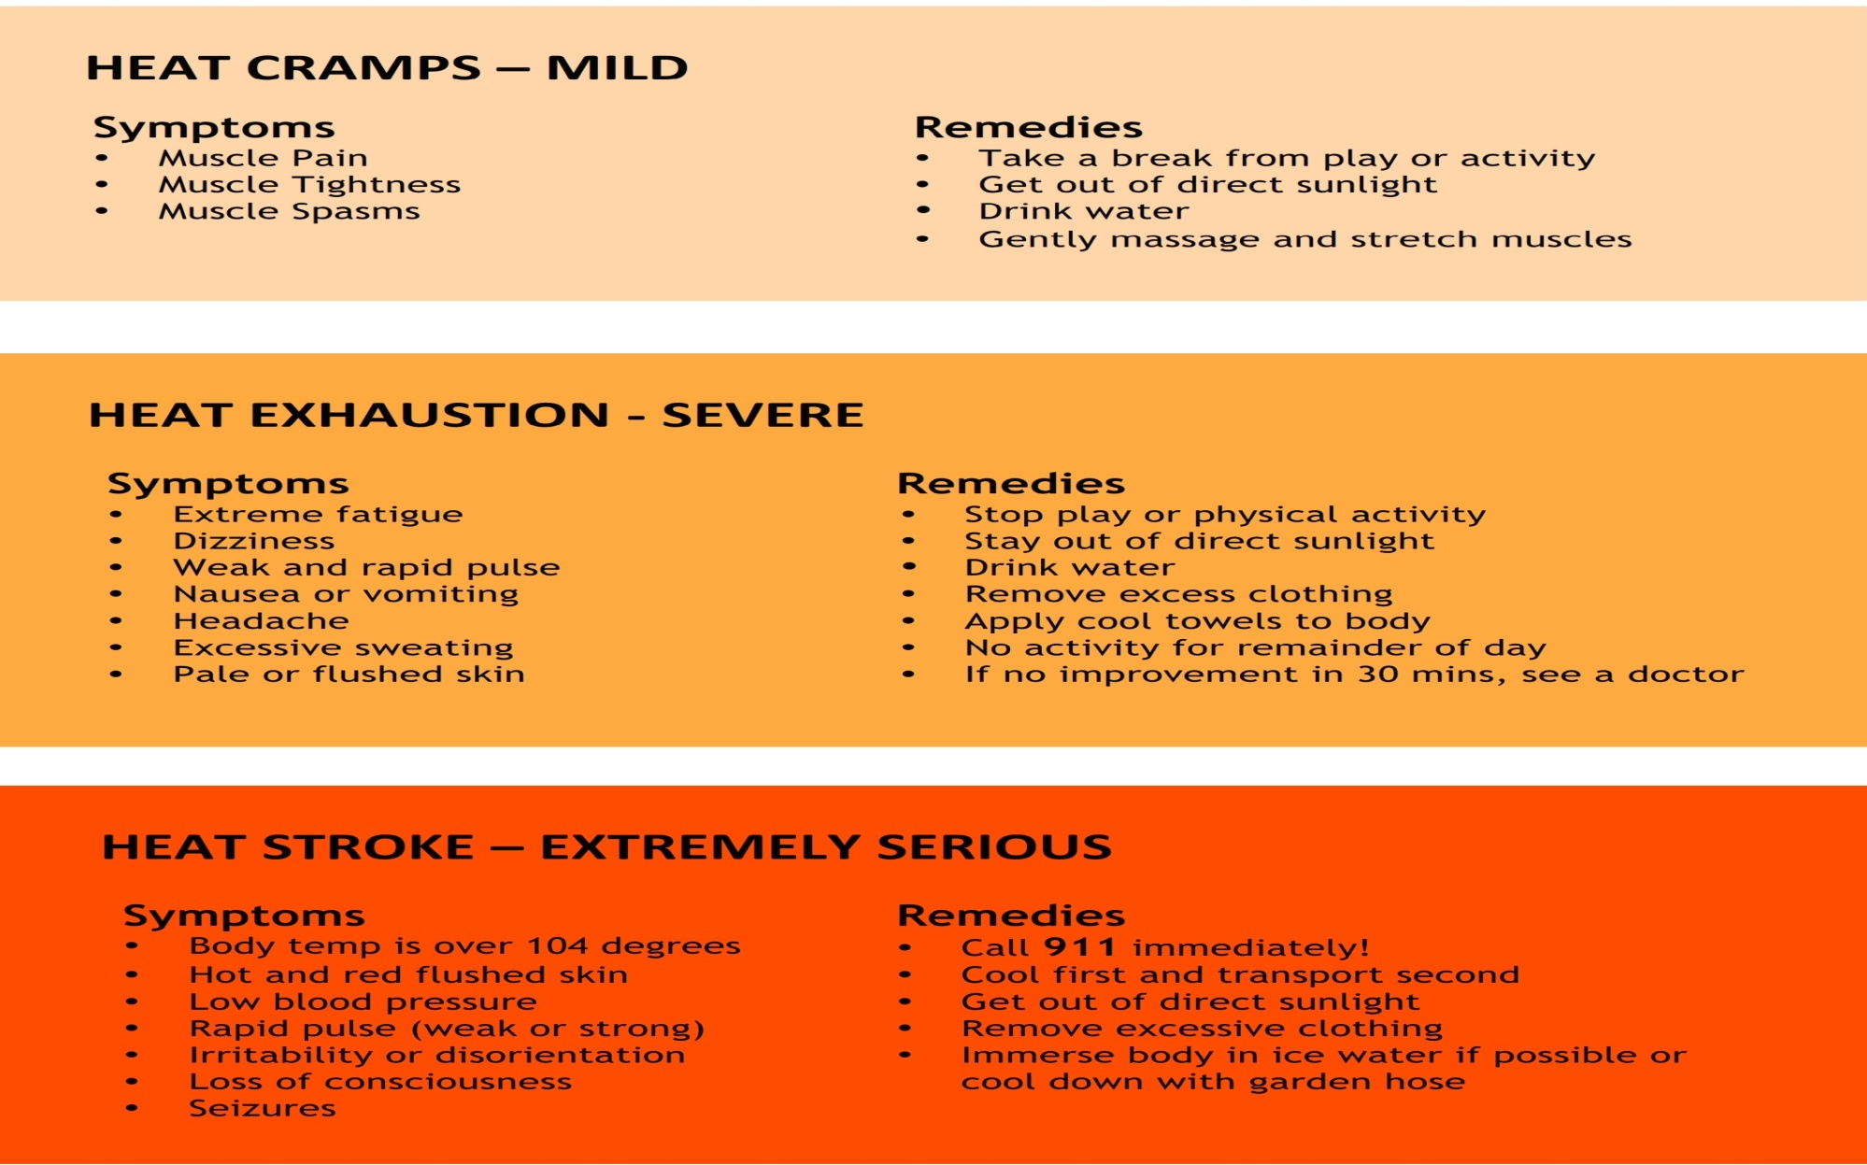
Heat
related injuries
and
Treatment.

Slide 57

Concussions
WHAT IS A CONCUSSION?
Concussion, a type of traumatic brain injury, is caused by a bump, blow, or jolt to the head. Concussions can also occur from a blow to the body that causes the head and brain to move quickly back and forth— causing the brain to bounce around or twist within the skull.

Slide 58
Concussions - http://www.cdc.gov/headsup
SIGNS OBSERVED BY COACHING
• Appears dazed or stunned
• Is confused about assignment or position
• Forgets an instruction
• Is unsure of game, score, or opponent
• Moves clumsily
• Answers questions slowly
• Loses consciousness (even briefly)
• Shows mood, behavior, or personality changes
• Can’t recall events prior to hit or fall
• Can’t recall events after hit or fall
SYMPTOMS REPORTED BY ATHLETE
• Headache or “pressure” in head
• Nausea or vomiting
• Balance problems or dizziness
• Double or blurry vision
• Sensitivity to light
• Sensitivity to noise
• Feeling sluggish, hazy, foggy, or groggy
• Concentration or memory problems
• Confusion
• Just “not feeling right” or “feeling down

Slide 59
Concussions
How you can help decrease an athlete’s chance of getting a concussion:
Talk with athletes about the importance of reporting a concussion
  Emphasize that safety comes first and you expect them to tell you and their parent(s) if they think they have a concussion.
Create a culture of safety at games and practices:
Teach athletes ways to lower their chances of getting a concussion.
Enforce the rules for fair play, safety, and sportsmanship.
Ensure athletes avoid unsafe actions (e.g. striking another athlete in the head, using head/helmet to contact another athlete; making illegal contacts, etc.)
Tell athletes that you expect good sportsmanship at all times,
both on and off the playing field.

Slide 60
Risk Management: Insurance
Mandated insurance: Required for all Pop Warner Associations. Provides protection for practice fields, game fields, fundraisers, volunteers and drivers.
  CDPW provides accident insurance to all Associations
      It is a secondary policy with a $100 deductible.
      An Injury Report MUST be submitted to the appropriate League Commissioner within 5 days of injury.
  CDPW also maintains $2 million liability coverage.

Slide 61
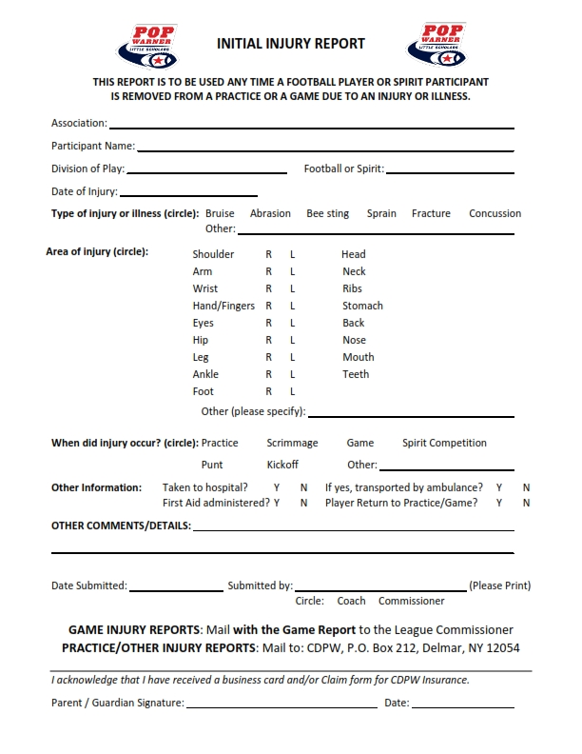
injury Report
Must be filled out any time a participant is withdrawn from game or practice due to injury.
Practice Injury reports must be filed immediately with CDPW.
Parent or guardian should acknowledge receipt of the insurance form by signing the Injury Report.
Game injury reports MUST be sent with game reports

Slide 62
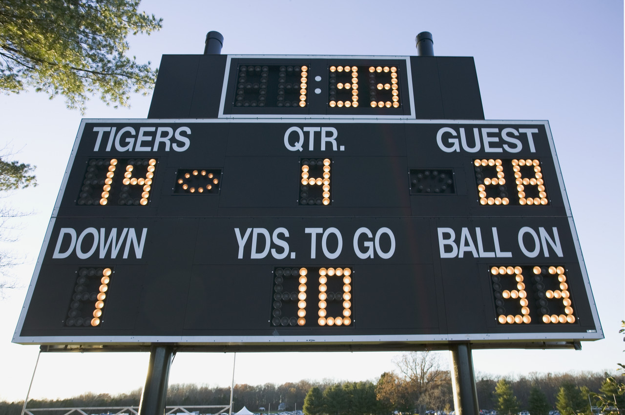
Unit 4: Game Day Procedures
COMMISSIONER’s GUIDE

Slide 63
GAME Commissioner
The Home Team’s Commissioner acts as the Game Commissioner.
The Game Commissioner is responsible for:
    conducting football check-ins and cheer check-ins
    maintaining control of the game, including crowd control (with assistance from visiting team Commissioner)
    submitting the Game Report and reporting the score of the game to CDPW

Slide 64
Pre-Game: Commissioner TASKS
Introduce yourself to the officials and head coaches; introduce them to each other.
Verify and identify who will be responsible for providing medical attention, if required.
Confirm that the ratio of participants to adult coaches is 12:1 for football and cheer squads.
Obtain 3 individuals (16+ yrs.) for down marker and yardage change. Visiting team should supply at least 1 person.
Check size of football(s) to be used:
  FLAG 8u ---- K2
  10U----- TDJ
  12U ------- TDY

Slide 65
Tackle Game Officials
  4 Officials should be assigned.
    Games and /Scrimmage may be played with 3 officials.
Home Team Game Commissioner must pay officials during halftime with an Association check.

Slide 66
Medical Coverage
Medical coverage during games and practices is the responsibility of the HOME Association.
Ranking of Medical Coverage:
  Physician
  Licensed physician’s assistant
  Nurse practitioner
  Paramedic
  Emergency medical technician (including EMT-FR)
  Certified multi-medical Red Cross card carrier or equivalent
  (nurses do not qualify unless they fall into one of the above categories)
When available coverage is equal rating, the home team coverage will prevail.

Slide 67
AGED BASED
DIVISIONS
5-6-7 Flag
7-8 yr olds (8U)
8-9-10 (10U)
10-11-12 (12U)

Slide 68
Pre-Game Check-In
Only Game Commissioners may conduct check-ins.
Team Books must be turned over to Game Commissioner for check-in one hour prior to scheduled start of game. check-in must be completed within 15 minutes of kickoff.
The Visiting team Commissioner, must be check in home team.
Coaches are only allowed in the check-in area for disciplinary reasons (at the discretion of the Game Commissioner).
Upon completion of check-in, Team Book is returned to team representative but shall be made available to the Game Commissioner at his/her request at any time during the game.

Slide 69
Pre-Game Check-In (cont’d)
Home team is responsible for providing a suitable enclosure for pre-game that provides adequate cover .
Check-in home team first.
Players should line up in jersey number order and state their name and jersey number out loud.
Check players’ helmets – achievement awards not allowed.
Once checked-in, record date and player’s status; and your initials on ID card.
Immediately following the football players' check-in, the Commissioners will check in spirit participants and initial each ID card.

Slide 70
Tardy Participants
If players or cheerleaders arrive late:
  less than 15 minutes before kickoff → cannot play or cheer first half
  during first half → weigh-in /check-in at half-time and may play second half
  after end of second quarter → not qualified to play

Slide 71
Game Time:
Sportsmanship Statement
At all football games and cheer competitions, the NYS Public High School Athletic Association Statement on Sportsmanship (modified for Pop Warner) should be read over the loud speaker (if available) prior to the start of the game, or at the Official’s meeting at the 50-yard- line prior to the coin toss.
Sportsmanship Statement
The Capital District Pop Warner Football Federation requires officials to enforce all sportsmanlike rules for athletes and coaches. We will not tolerate negative statements or actions between opposing players, especially trash-talking, taunting or baiting of opponents. If such comments are heard or actions seen, a penalty will be assessed immediately. We have been instructed not to issue warnings. Let today’s contest reflect mutual respect.

Slide 72
Game Time Regulations: Field ID Tags
ONLY individuals on the official team roster and with the appropriate field identification tags are allowed on the field of play.
The following individuals will receive ID Tags for CDPW
  CDPW Board Members
  Association Presidents
  Football / Spirit Team Head Coaches
  Football / Spirit Team Assistant Coaches
  Team Commissioners
  Statisticians and Spotters

Slide 73
Game Time Regulations
The home team shall supply a fence, rope or other restraining device to keep spectators a minimum of ten yards (10) from the playing field
A maximum of ten (10) rostered team personnel may be inside the 25-yard markers and within coaches’ box.
  1 Head Coach, 5 Assts., 1 Coach Trainee, 1 Commissioner, 1 equipment manager, and 1 certified trainer.) All others must stay behind the restraining device, except for the pre-game identified medical person.
Cheer/dance participants may be within five (5) yards of the playing field, but may not be within the 25-yard markers.
  Exception: field has suitable space behind the football player’s bench, such as a running track around the field. However, squad may NOT be inside the football player’s “box.”

Slide 74
Game TIME Regulations (Cont’d)
No radios or other communicative devices, including cell phones, are allowed during game situations to relay information to the coaching staff on the sidelines.
Games may be videotaped but cannot be shown at halftime.
Sideline officials (statisticians, spotters, chain crew) should refrain from cheering, etc.
Once a game has started, only the head official can call the game off.
A Game Commissioner can not call a time out but may request a time out from the head coach in order to talk to the referee if there is a circumstance pending on the field.

Slide 75
Minimum Player Rule
A minimum of 16 tackle players (10 for Flag) dressed and eligible for play are required to start a game; you may finish a game with 15 players.
If the count of eligible players falls below 15 (10 for Flag), the game will immediately be suspended.
The CDPW Commissioner should be notified immediately, and a continuation game will be played on the following Wednesday night.
  All players who were eligible to play at the start of the suspended game will be allowed to play in the continuation game.
If a game is suspended for any other reason, (inclement weather, etc.), the game will also be continued on the following Wednesday night.
  Only players eligible to play at the time the game was suspended will be allowed to play in the continuation game.

Slide 76
Minimum Play Requirement (MPR)
Coaches shall follow the MPR rule (based on # of eligible players at time of game):
  16 – 25 players → 10 plays (12 for 8U)
  26 – 30 players → 8 plays (10 for 8U)
  31 – 35 players → 6 plays (8 for 8U)
  Flag → All players receive 10 plays
MPR must be met for all players by the end of the 3rd quarter – otherwise, player(s) must enter the game at the start of the 4th quarter and remain in game until MPR is met.

Slide 77
What plays count toward MPR?
The plays must be from the line of scrimmage.
All players shall be provided their mandatory plays by participation in “active” plays, without the intent to minimize the action or integrity of the plays.
Plays such as, but not limited to, having the center snap the ball to the quarterback, and then the quarterback fall to the ground, while substitutes are playing the other positions, shall NOT be considered as active plays.
The following do not count toward MPR:
  Kickoffs, extra points, and free kicks
  Plays that result in a penalty which causes the down to be replayed
  QB takes a knee or intentionally spikes the ball

Slide 78
FAILURE TO ADHERE to MPR
Failure to adhere to MPR requirements will result in:
  Minimum fine of $200 plus forfeiture of game.
  The Coach will receive probation for one year
    If violation found to be intentional, coach will also be suspended from games/practices for 1 week.
  A player denied his required number of plays will start the next game and receive double the number of mandatory plays in that game. Failure to comply with this provision will be deemed a second violation.

Slide 79
MPR: Statisticians
Each team will provide at game time a numerically listed statistician form including starting offense and defense, and player’s jersey number.
Home team statistician records minimum plays for the visiting team on the visitor side of the field. Visiting team statistician records the minimum plays for the home team players on the home side of the field. There should be a spotter for each statistician.
At half-time, Game Commissioner should request the statistician count of players who have not completed their MPR and inform the respective head coach. Repeat at the end of the 3rd quarter (if necessary).
Notify each head coach when all of his players have completed the minimum play requirements.
Statistician must sign and date the Statistician Form.

Slide 81
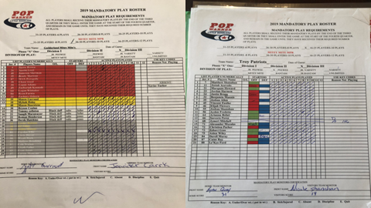

Slide 82
Lopsided/Intentionally Run Up Scores
“28 Point Rule”
Any time a team goes up by 28 points, the following will occur:
Official clock becomes a running clock immediately when the 28th point is scored. Once started, the clock can only be stopped for injury of a player and cannot revert to a game clock operation for the remainder of the game.
The winning team cannot pass the ball or run sweeps outside the tackle. If the winning team fails to abide by this rule, each violation will be a loss of down and a 5-yard penalty. This is at the discretion of the game referee.
There will be no blitzing by either team.
There will be no onside kicks at kickoff by the winning team.
The winning defense team cannot advance a fumble or pass interception. The ball is blown dead immediately. The winning offense may start play action from this point.

Slide 83
The losing Team’s Defense:
  Must use either a 4-3 or a 3-4 defense with linebacker set at least 5 yards off the line of scrimmage and defensive backs at least 10 yards off the line of scrimmage.
  Must cover all split receivers/wide outs man for man
The winning team must make every effort to replace starting players with reserves. Failure to do so will call for an immediate investigation and possible one game suspension if found guilty.
Any coach who employs types of plays without the intent to maximize the action of play shall be in violation of this rule.
The teams are still required to complete the mandatory play rule.
An investigation will be conducted any time a game ends with a score differential of 28 points or more.

Slide 84
Other Game time Rules
Clipping is illegal anywhere on the field including free-blocking zone.
No kickoffs for 7/8, 8/9/10.
. To start the game or the 2nd half, or after TD, field goal or safety, the ball will be placed on the 35 yard line.
2 point stance for offense and defensive linemen must be used in the following levels of play: 7/8, 8/9/10.
ALL LEVELS WILL PUNT THERE IS NO WALKING IT OFF
8U LEVEL PUNT IS LIVE AFTER KICK

Slide 85
Tie Ball Games
In the event a game ends in a tie, the National Federation of State High School Associations shall govern the tiebreaker:
  4 downs from the 10 yard line

Slide 86
Player Ejection
If a player or spirit participant is ejected from a game, ejection MUST be noted on the Game Report.
Ejected child shall be ineligible for participation at next game.
If the child is ejected from a second game (same season), child will be ineligible for remainder of season.

Slide 87
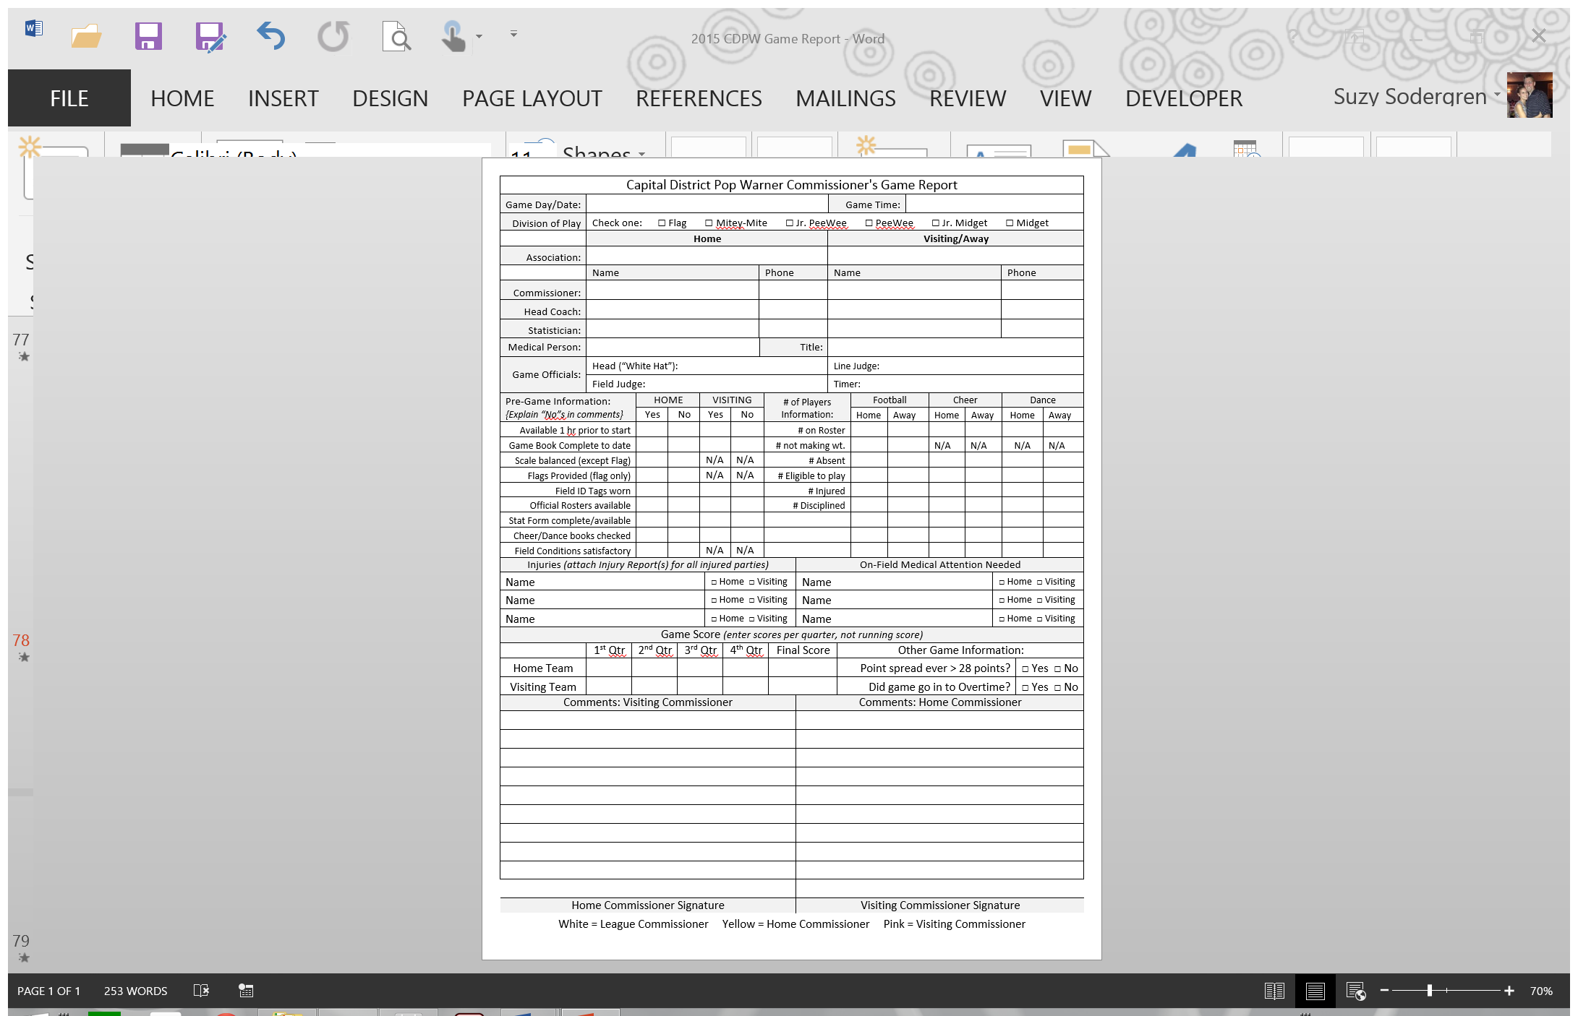
Post-Game: Game Report
The Game Commissioner is responsible for completing the Game Report and submitting it to CDPW.
The Game Report should include:
  Names of Coaches, Commissioners, Officials, Statisticians, and present medical personnel
  Game score by quarters (not a running score) and a final score
  Any remarks from Coaches, Commissioners, or Officials involving character of the game, players, and coaches.
  Record of all injuries, disciplinary actions, game violations and/or suspected game violations.
  Any incidents involving cheer/dance participants.
  Home and Visiting Team Commissioners must sign the COMPLETED game report acknowledging all comments (even though they may not agree with the content).

Slide 88
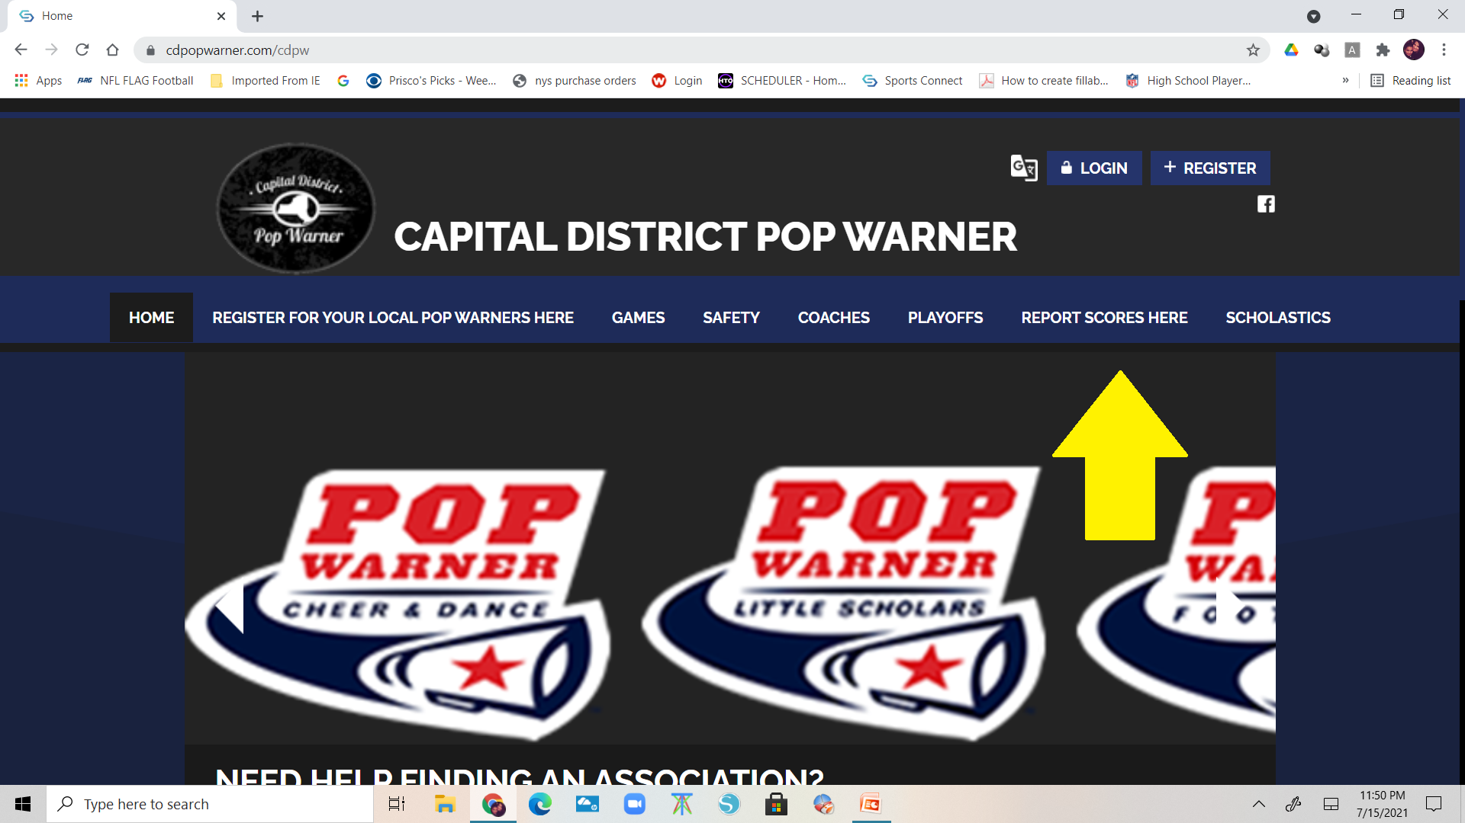
REPORT THE SCORE

Slide 89
SPECIAL NOTE FOR 8U
8u Coaches are allowed on the field for the full season.
A maximum of one (1) coach per team is permitted on the field and must be 10 yards from line of scrimmage
May not be on the field during punts.
There shall be no blitzing, no rushing of: punts, field goals or point after touchdown (while attempting a kick) in 8u play

Slide 90
NEW 8u
No more than six defensive players can be on the line of scrimmage or rush the ball, no one over the center AND ALL PLAYERS ON LINE OF SCRIMMAGE ARE IN A 2 POINT STANCE
Linebackers 3 yards off the line of scrimmage
Corners 5 yards off the line of scrimmage
Safeties 7 yards off the line of scrimmage

Slide 91
SPECIAL NOTE FOR 8U (cont’d)
8U teams are only permitted to play (2) post-season games in their own or an adjacent league/conference (excluding 8U National Invitation Bowl Games).
This allows for replacing one Regular Season 8U Game with a second Post Season Bowl game. It also allows overnight travel to an adjacent league/conference.

Slide 92
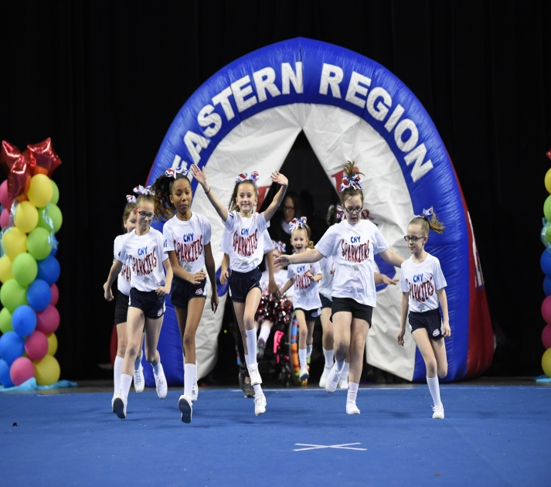
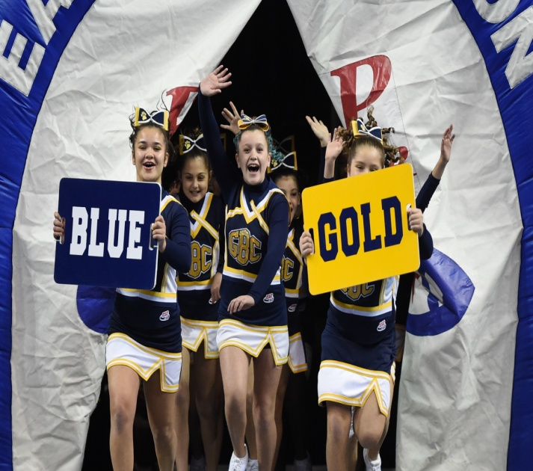
CHEER COMPETITON
TENTATIVE DATES
CDPW
October 8
Schenectady High
Regional
November 6 and 7
Trenton NJ
Nationals
December 5-8
Universal Studios Florida
YCADA Globals
February 24-26, 2023
Atlantic City NJ

Slide 93
Unit 5: Keeping Youth Sports Fun
Coaches’ and Parents’ behavior

Slide 94
How to keep Young Athletes involved
Emphasize learning new skills and improving existing ones. Let the athletes be proud of all they are learning about the sport.
Have Fun. Be positive and have fun yourself!
Maintain a safe environment, both physically and emotionally. Do not allow participants to ridicule each other.
Challenge Athletes with Physical Exercises in a Creative Way. Use relay races and challenges to do conditioning.
Give participants a Sense of Belonging to a Team. Consider a team slogan or team shirts.

Slide 95
Use Effective Feedback
Positive feedback is key. Research shows that the most effective teachers use 5 times as many positive statements as they do negative statements.
  Catch athletes doing things correctly.
  Be specific & concise.
  Focus on strengths more than weaknesses.
  Give feedback promptly and immediately.
  Be sincere when giving praise.
  Reward improvements, not perfection.
  Reward effort as well as outcome.
  Avoid being insulting and negative.

Slide 96

Coach and Parent Misconduct

Slide 97
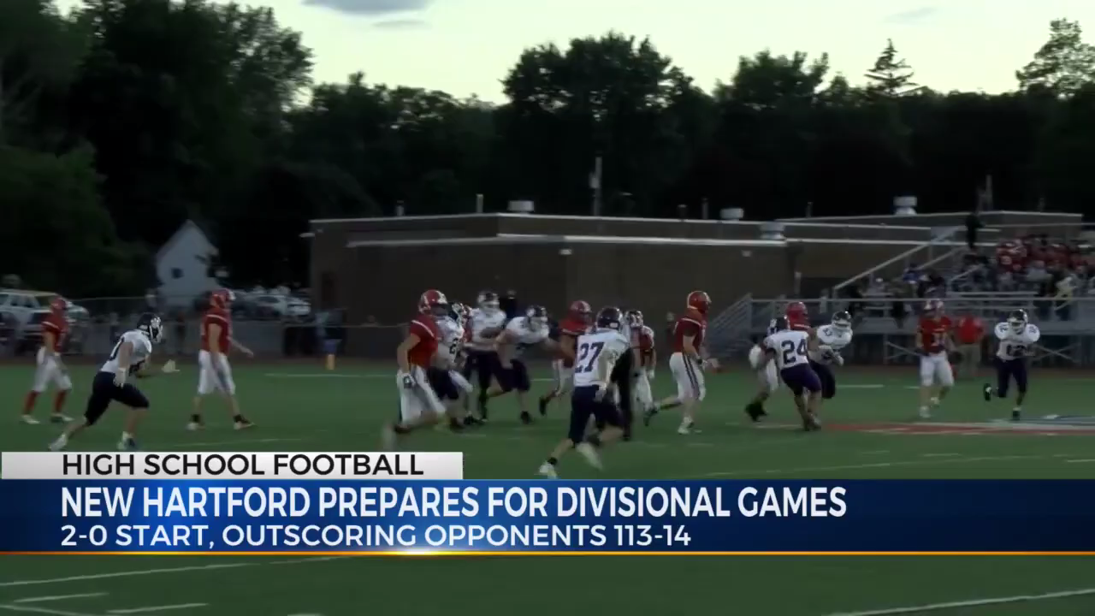
Coach and Parent Misconduct

Slide 98
Coach and Parent Misconduct
Pop Warner has become increasingly concerned about the numbers of incidents of parental violence and misbehavior of coaches.
The newspapers and TV are full of stories about youth coaches and parents ruining youth sports for the kids.
Your Association MUST have a ZERO tolerance for aggressive, disruptive, abusive, and disrespectful behavior.
CDPW will assist your Association in dealing with problem behaviors and disruptive individuals.

Slide 99
Coach & Parent Misconduct (cont’d)
It is the responsibility of each team to maintain spectator and coaching staff control during games. The Game Commissioner may ask the officials to penalize the team that fails to maintain control after one (1) warning.
Failure to maintain spectator and/or coaching staff control in pre-game, game and post-game situations could lead to an extreme penalty such as game forfeiture.
In the event an adult volunteer is ejected from a game, it must be noted on the Game Report and the ejected volunteer will receive an automatic one (1) week suspension (including all practices and the following game).

Slide 100
CODE OF CONDUCT
S1: Do Not smoke and/or use smokeless tobacco on the field.
S2: Do Not criticize players/spirit participants in front of spectators, but reserve constructive criticism for later, in private, or in the presence of team/squad members if others might benefit.
S3: Accept decisions of the game officials and judges on the field and in competitions as being fair and called to the best ability of said Officials.
S4: Do Not criticize an opposing team, its players, spirit participants, coaches, or fans by word of mouth or by gesture.
S5: Emphasize that good athletes strive to be good students and that both are physically and mentally alert.
S6: Strive to make every football and spirit activity serve as a training ground for life, and a basis for good mental and physical health.
S7: Emphasize that winning is the result of good teamwork.

Slide 101
S8: Do Not engage in excessive sideline coaching and do not leave the bench area to shout instructions from the sidelines.
S9: Together with team officials, be jointly responsible for the conduct and control of team fans and spectators. Any fan who becomes a nuisance and out of control will be asked to leave.
S10: Do Not use abusive or profane language at any time.
S11: Do Not “pile it on;”Do not encourage your team to get a commanding lead and raise the score as high as it can. In these instances, every effort shall be made to let all players play.
S12: Do Not receive any payment, in cash or kind, for services as a coach in Pop Warner Football/Spirit. This includes any coach, expert, consultant or choreographer, regardless of his/her roster status.
S13: Do Not permit or encourage “sweating down” tactics in order for a player to make the team weight.
S14: Do Not recommend or distribute any medication, controlled or over the counter, except as specifically prescribed by participant’s Physician.

Slide 102
S15: Do Not permit an ineligible player or spirit participant to participate in a game.
S16: Do Not deliberately incite unsportsmanlike conduct.
S17: Do Not possess or drink alcoholic beverages and/or use illegal substance(s) on both the game and practice fields.
S18: Do Remove from a game or practice any participant when even slightly in doubt about his/her health, whether or not as a result of injury, until competent medical advice is available.
S19: Be responsible for and Control their fans at all times.
S20: Uphold all rules and regulations, National, Regional & Local, regarding Pop Warner Football, Cheerleading and Dance.
S21: Refrain from engaging in any action within or outside Pop Warner which reflects negatively upon, or causes embarrassment to, the PW program.

Slide 103
I have read and understand the above rules. I agree to abide and enforce these rules that pertain to me.
I understand the violations will result in penalties authorized by National Pop Warner and the Capital District Pop Warner Federation.
I am requesting certification for the current season.
I understand that I am not certified until approved by the CDPW Board, have satisfactorily passed a background check , and are approved by my home association.

Slide 104
PWLS Members Code of Conduct
Please fill out the bottom completely and submit before you leave today.

Slide 105


Slide 106
Visit Us Online
National Website:
www.popwarner.com
Eastern Region:
www.easternregion.org
League Web Site:
www.cdpopwarner.com

Slide 107
Any Questions?
webmaster@cdpopwarner.com

